Slide 1
Turfgrass Irrigation Parts
Backflow Preventer
Ball valve
Clear pressure regulated rotor
Controller/Timer
Control valve
Decoder for 2-wire system
Dirty Water irrigation valves
Drip irrigation
Fittings
Elbow
Tee
Reducing tee
Flow sensor
Gate Valve
Glue
Lateral Line
Main Line
Master Valve
Nozzle
Pipe
Schedule 40
Schedule 80
HDPE pipe
Poly
PVC
Point of Connection
Pressure regulator
Primer
Quick coupler
Screen with check valve installed
Solenoid
AC
DC
Sprinkler controller wire
Sprinkler head
Rotary
Pop up
Swing joint with gasket
Valve Box
Valve-In-Head Sprinkler
Water cannon
Water wheel
Wire Connectors
DBRY-6
Epoxy
Wireless Transmitter

Slide 2
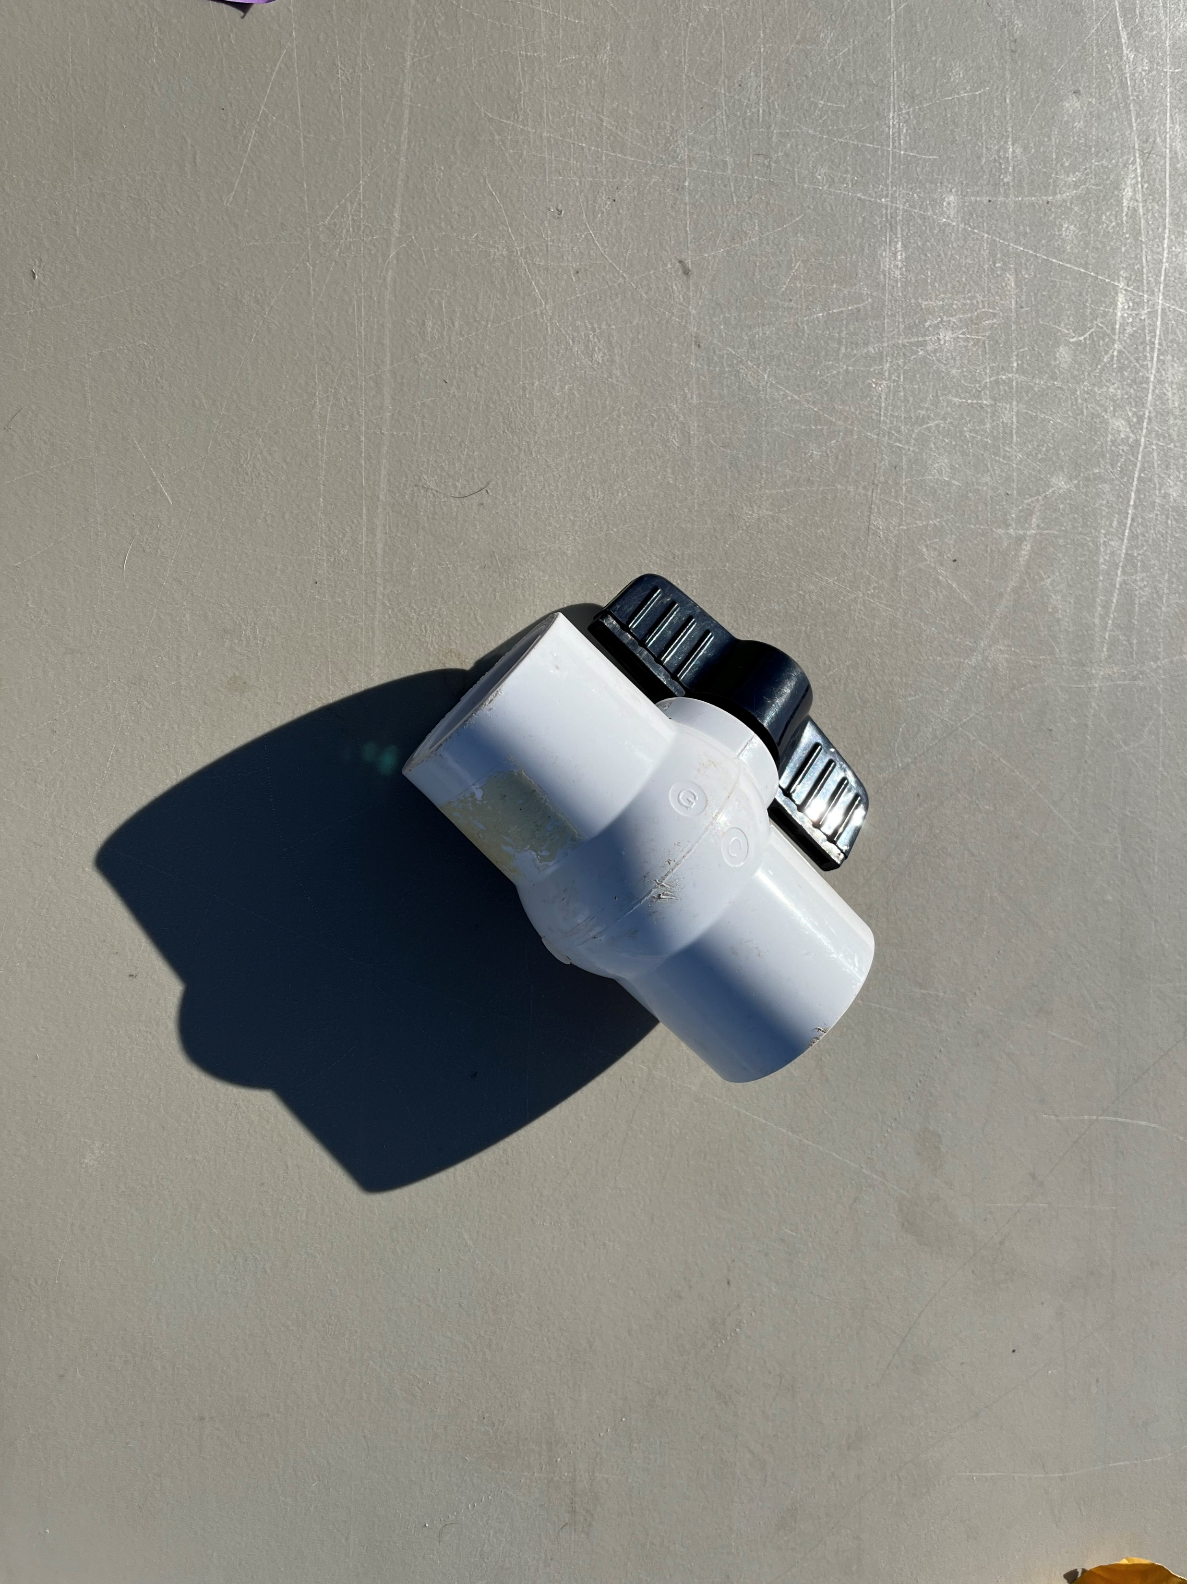
Notes:
Ball valve

Slide 3
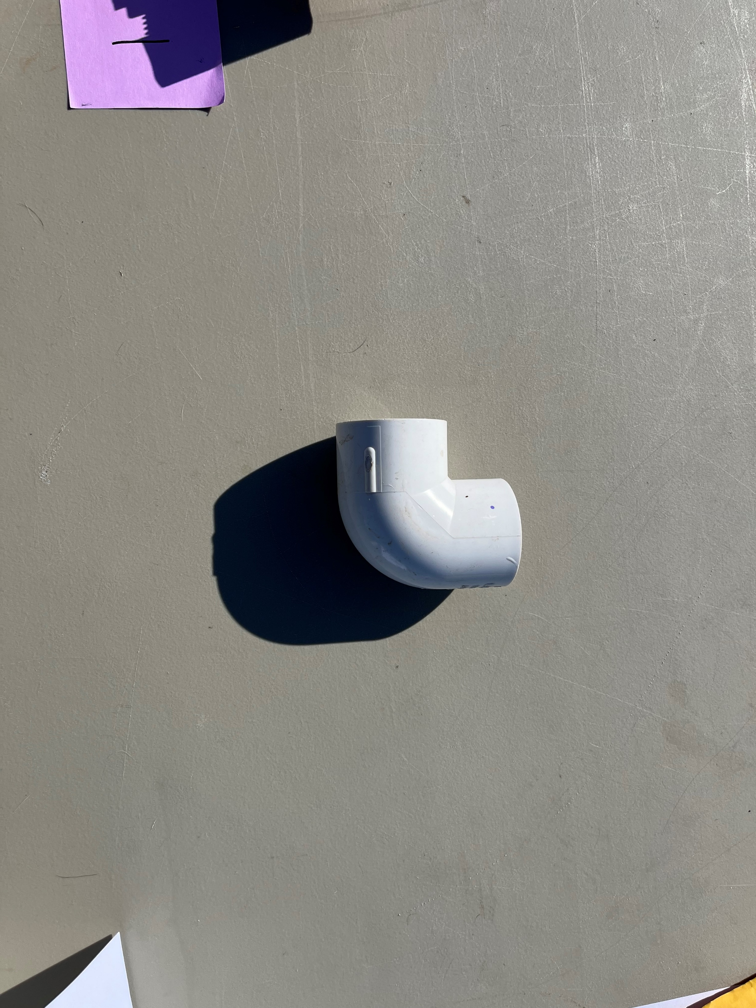
Notes:
Elbow

Slide 4
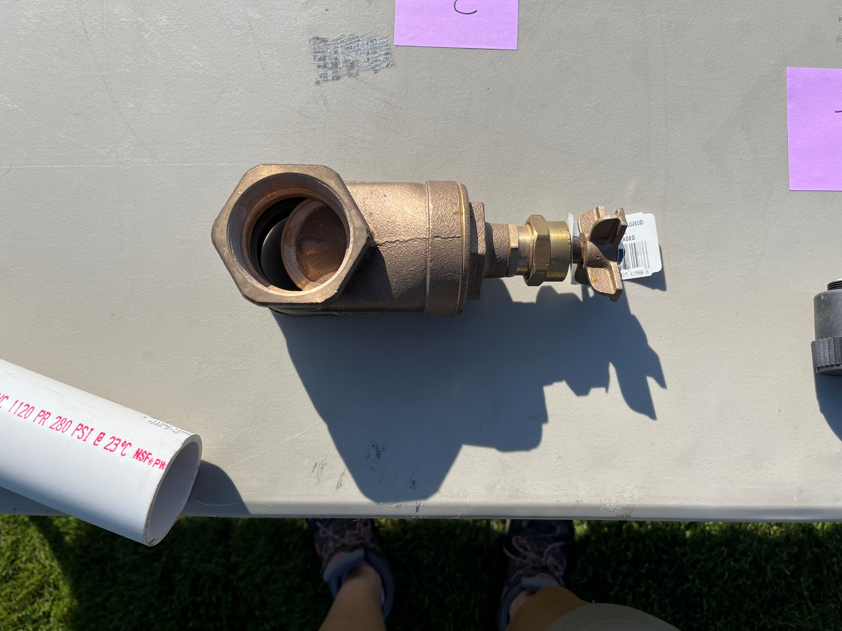
Notes:
Gate valve

Slide 5
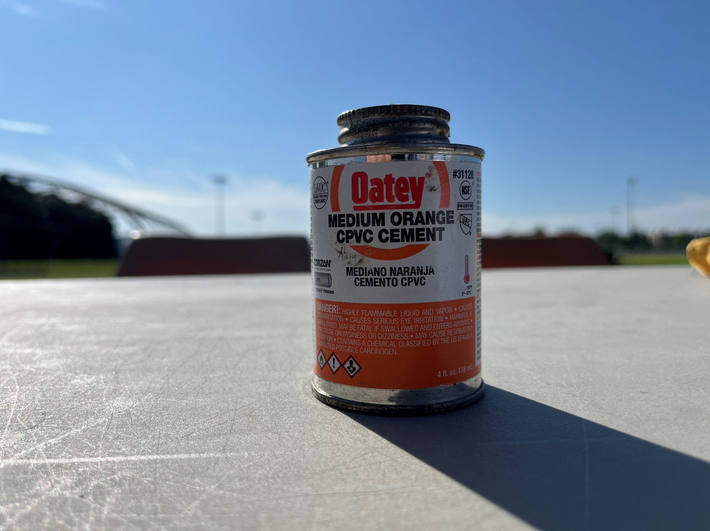
Notes:
Glue

Slide 6
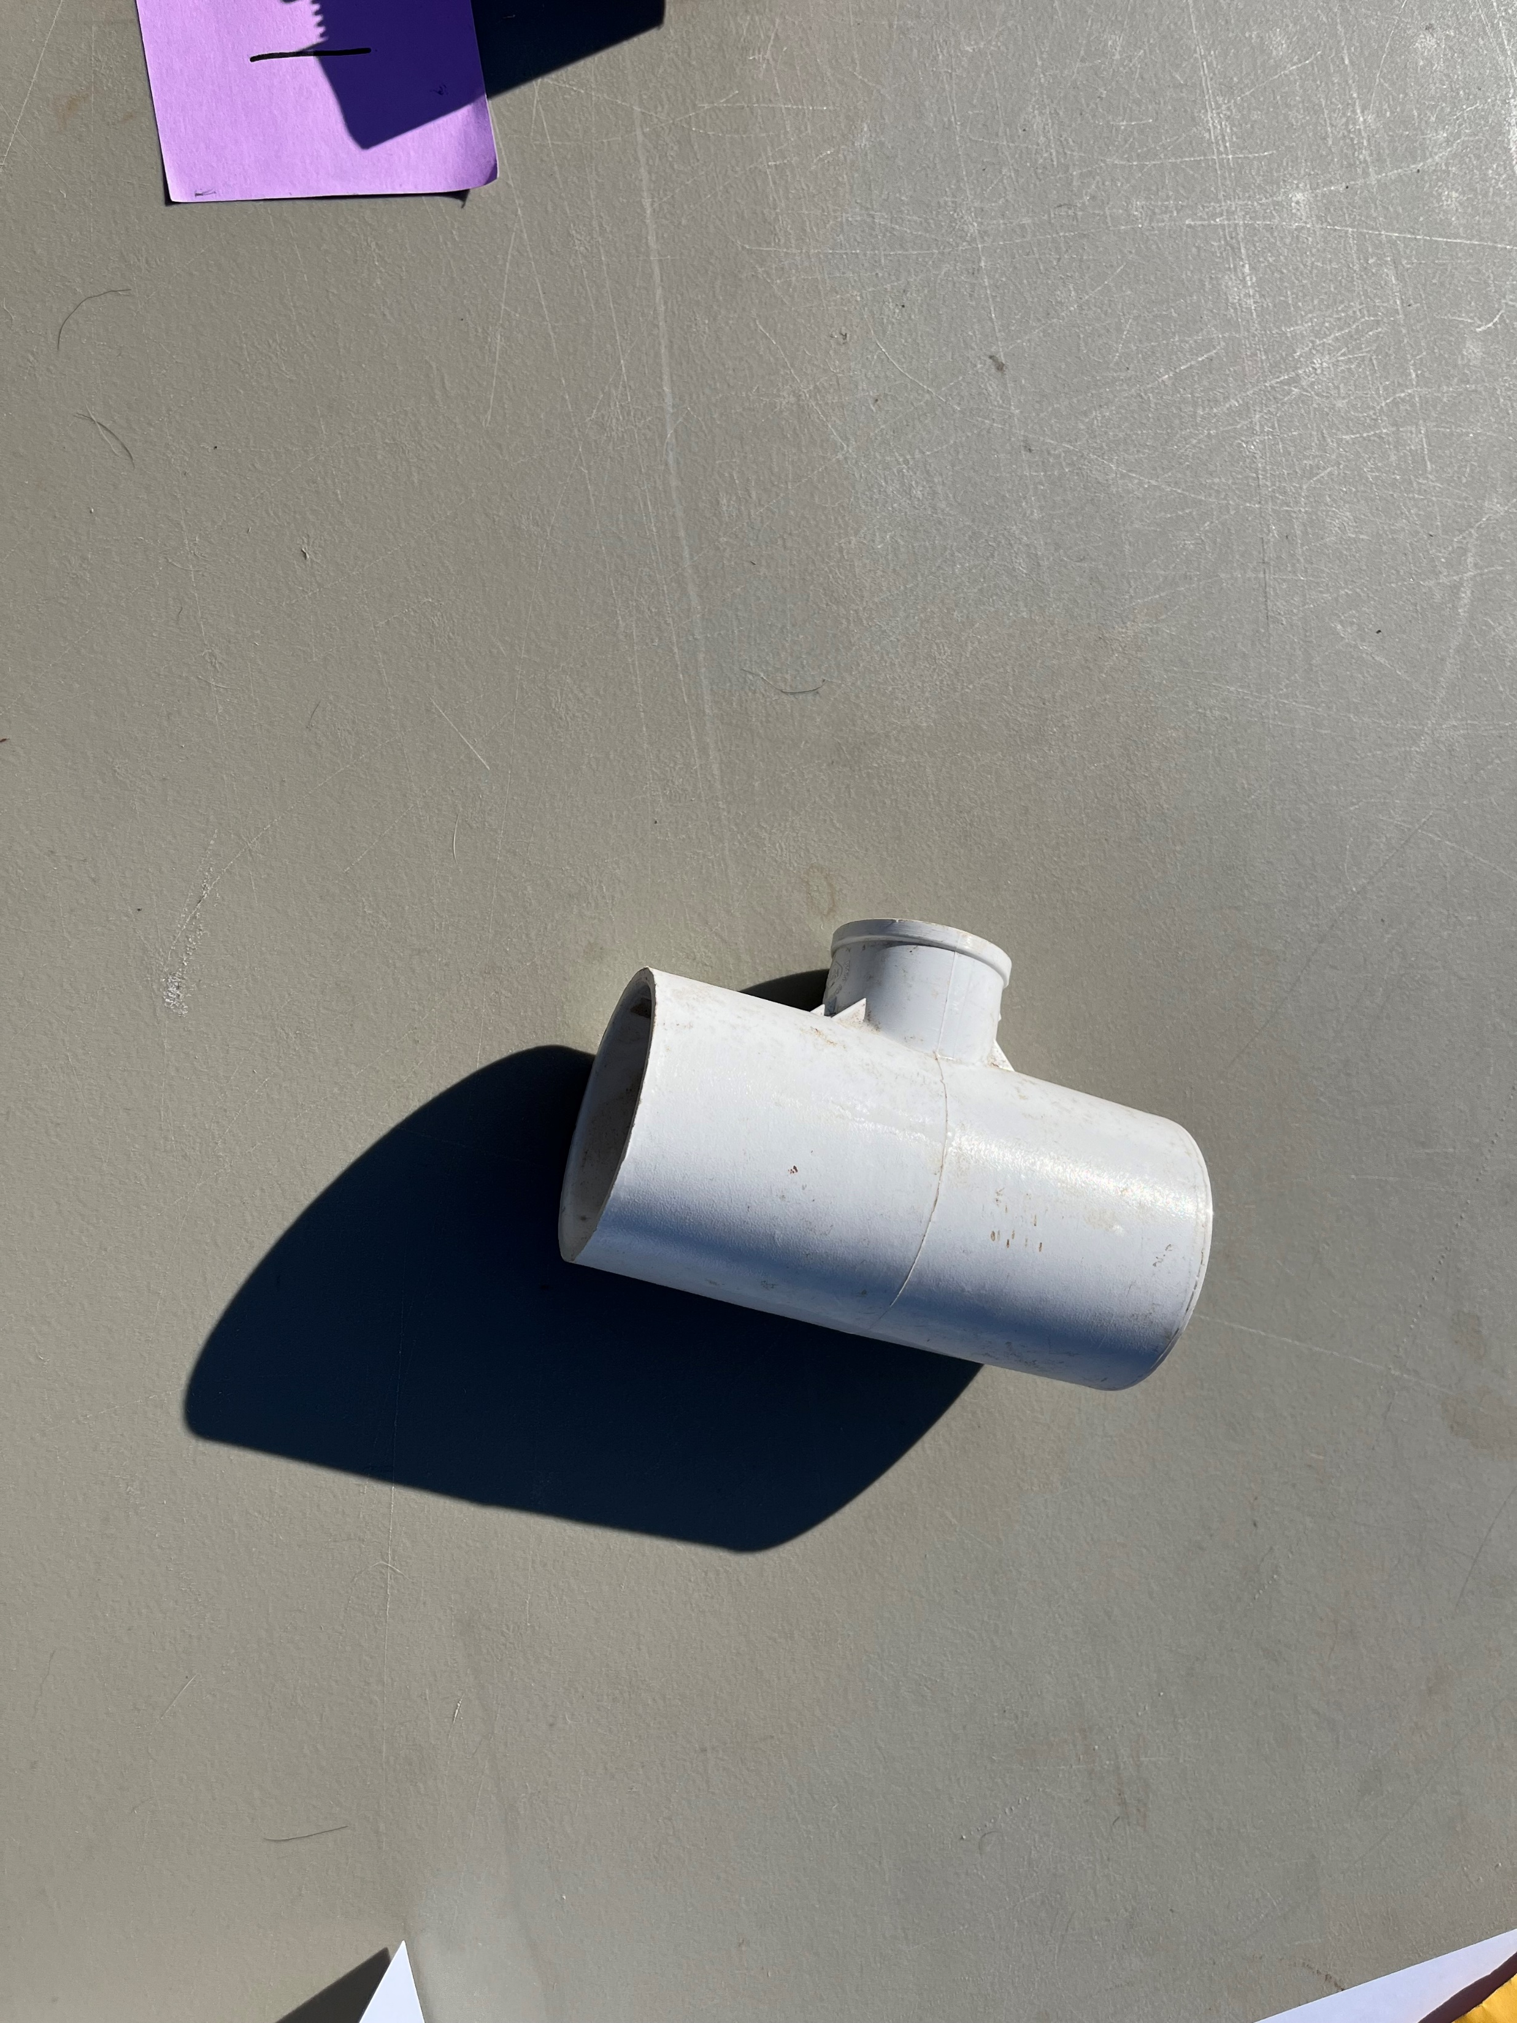
Notes:
Reducing tee

Slide 7
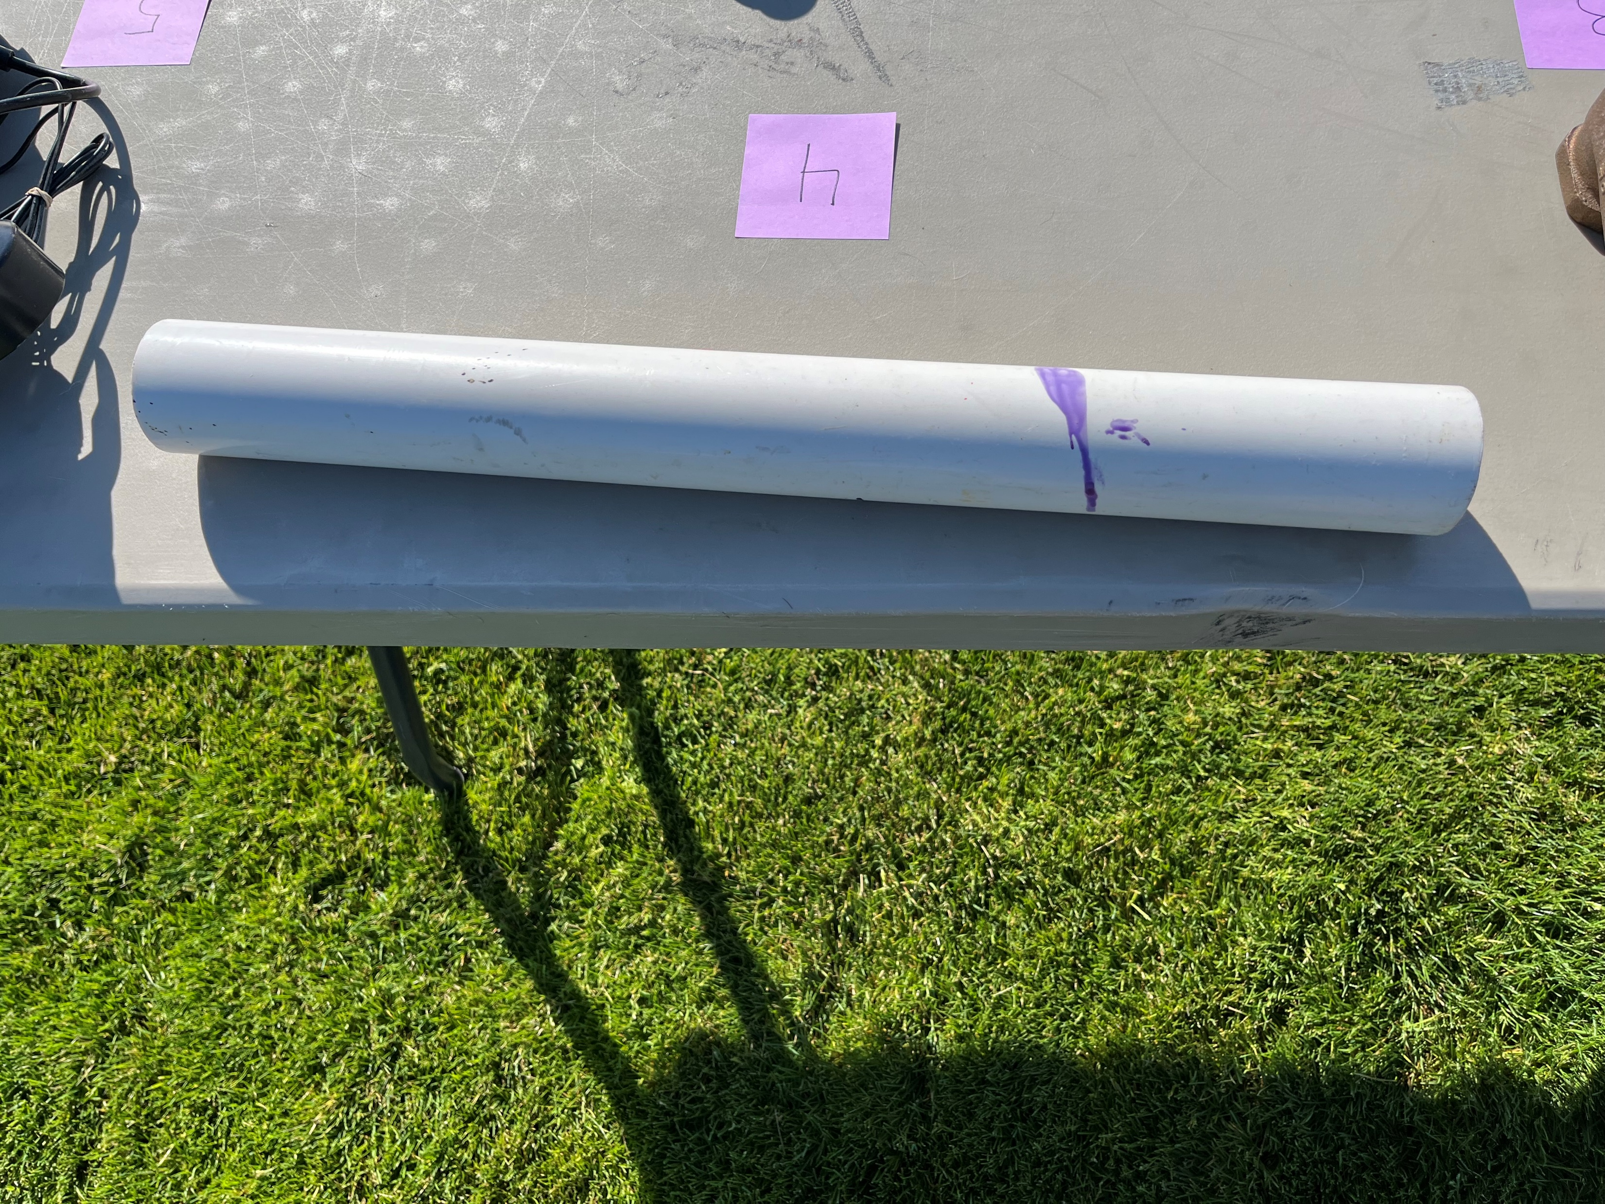
Notes:
Schedule 40 PVC pipe

Slide 8
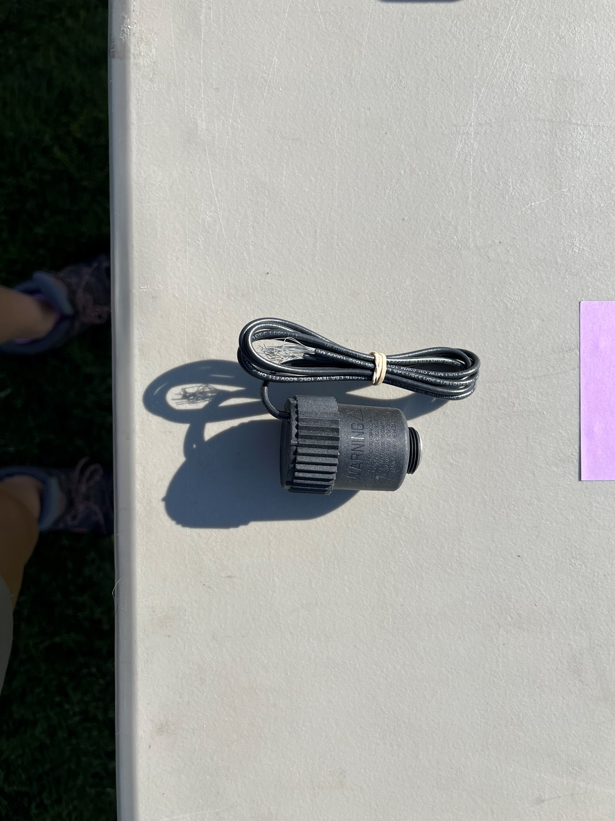
Notes:
Solenoid

Slide 9
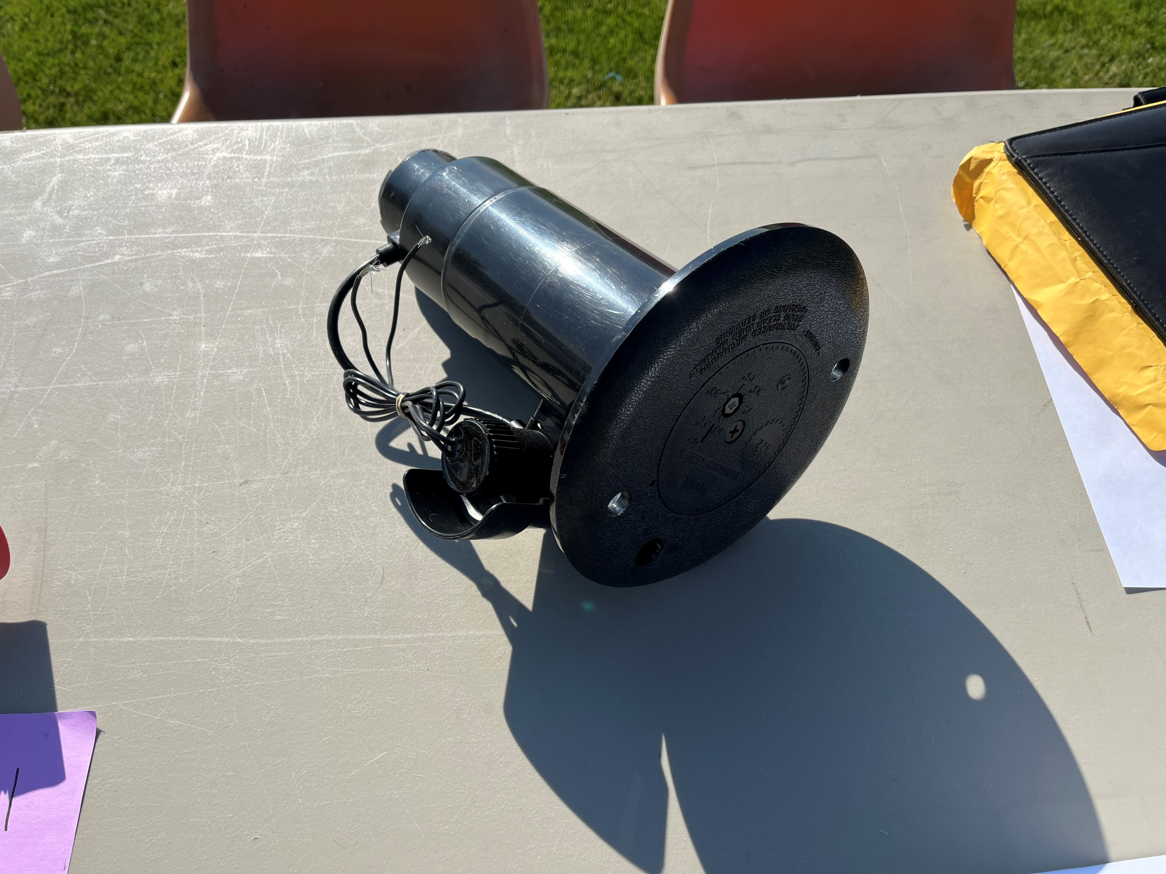
Notes:
Sprinkler head

Slide 10
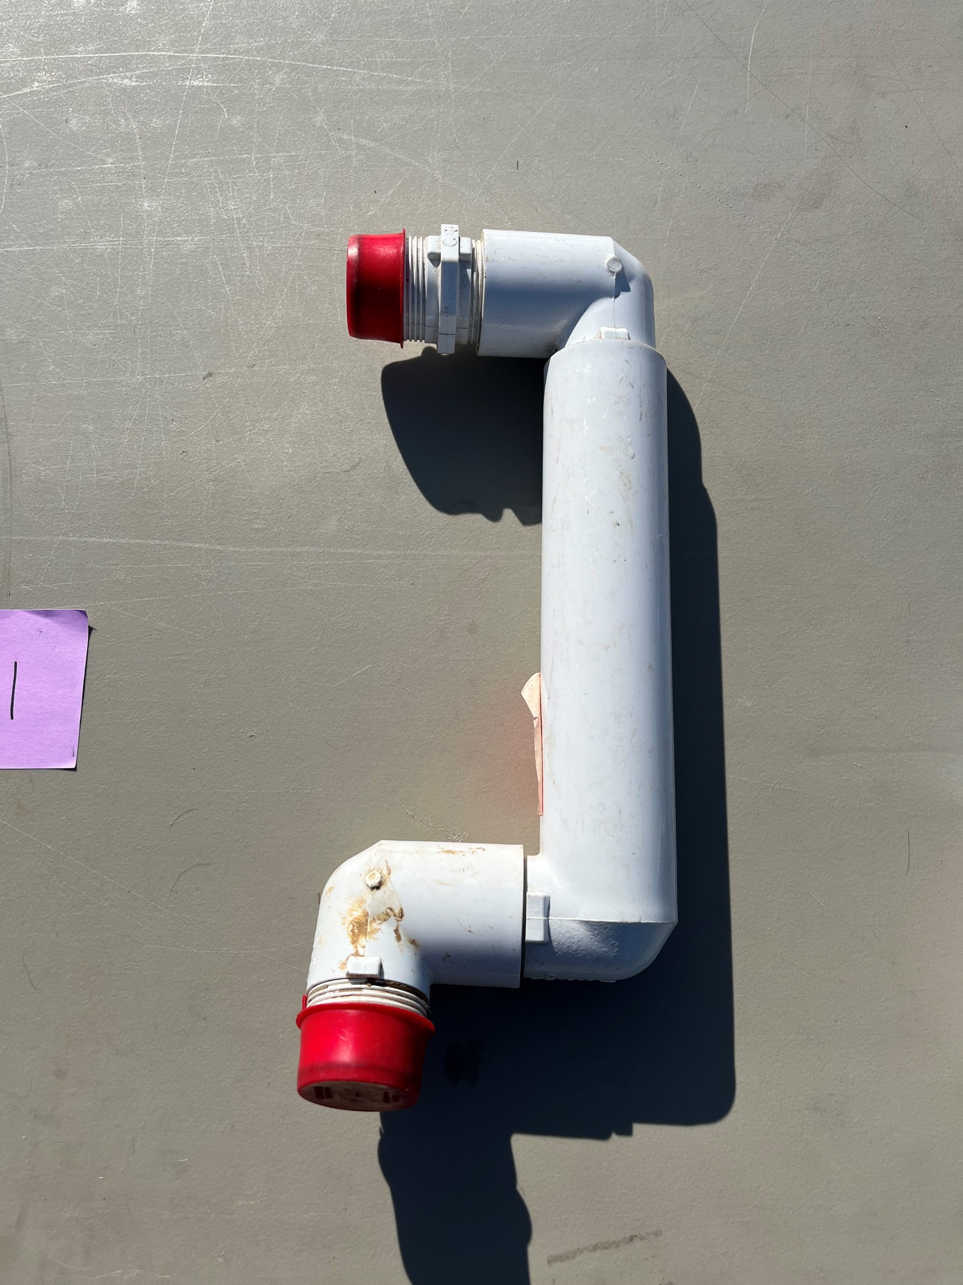
Notes:
Swing joint

Slide 11
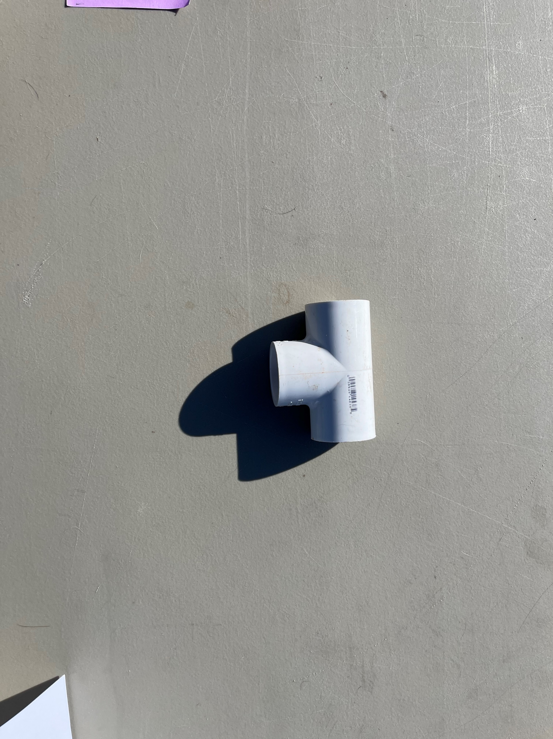
Notes:
T fitting

Slide 12
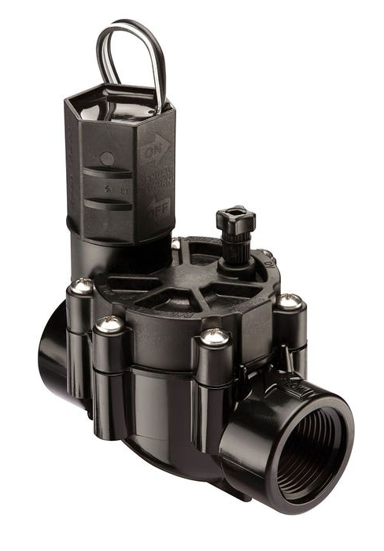
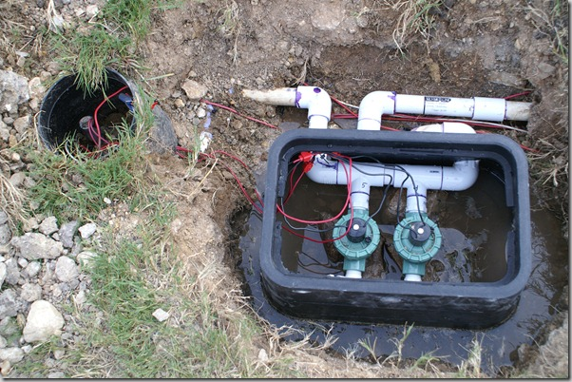
Notes:
Electric irrigation valves and valve box

Slide 13
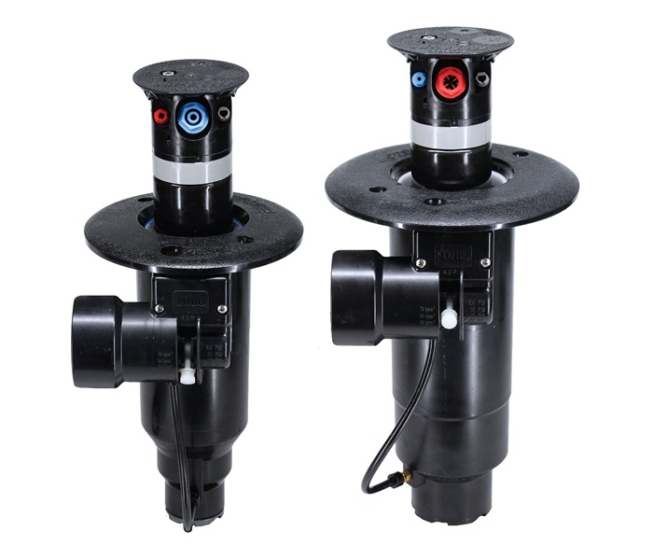
Notes:
Valve in head sprinklers

Slide 14
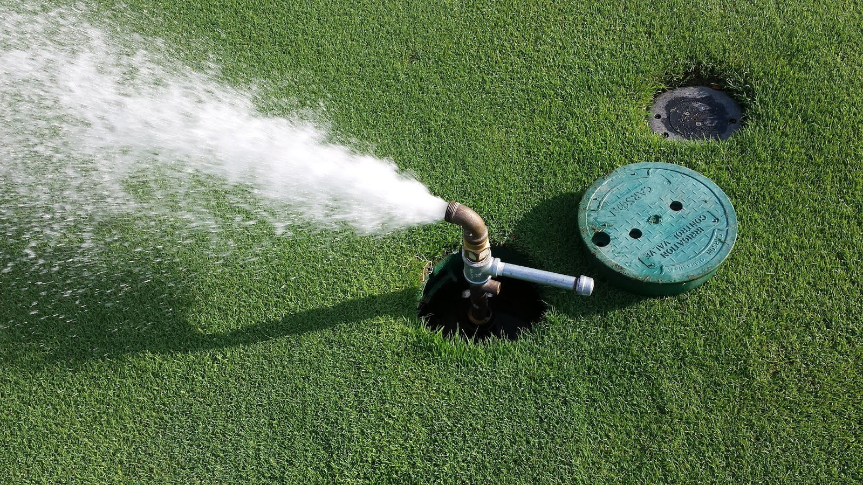
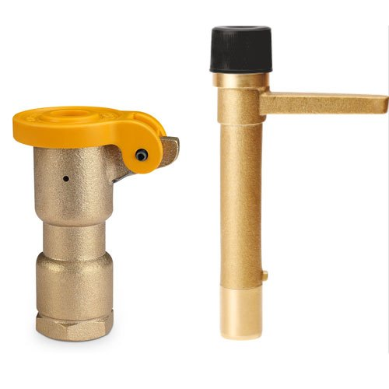
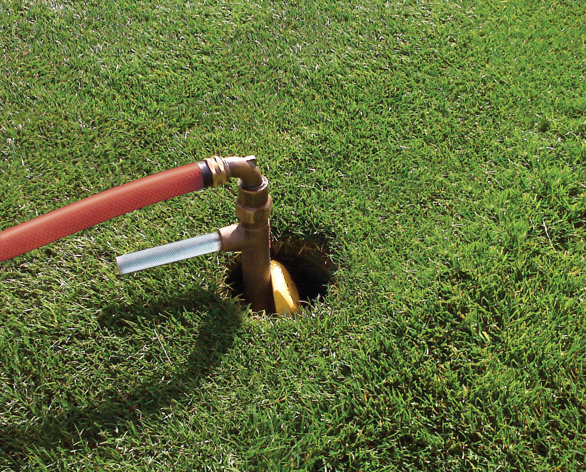
Multi-stream irrigation head
Rotary sprinkler head
Notes:
Quick couplers

