Slide 1
Turfgrass Insects
Annual Bluegrass Weevil
Armyworms
Asiatic Garden Beetle
Black Turfgrass Ataenius Beetle
Bluegrass Billbugs
Chinchbugs
Cutworms
Fall Armyworm
Fire Ants
Green June Beetle
Japanese Beetle
May and June Beetles
Masked Chafer
Mites
Mole Crickets
Oriental Beetle
Sod Webworms
White Grubs

Slide 2
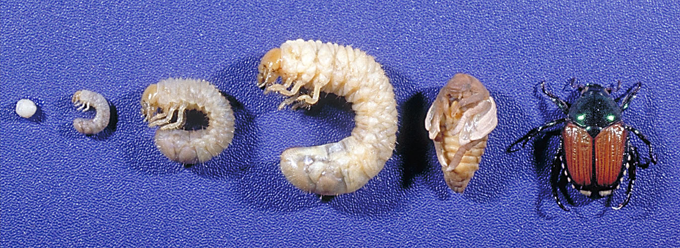
Insect development
egg 1st 2nd 3rd pupa adult
instar larva

Slide 3
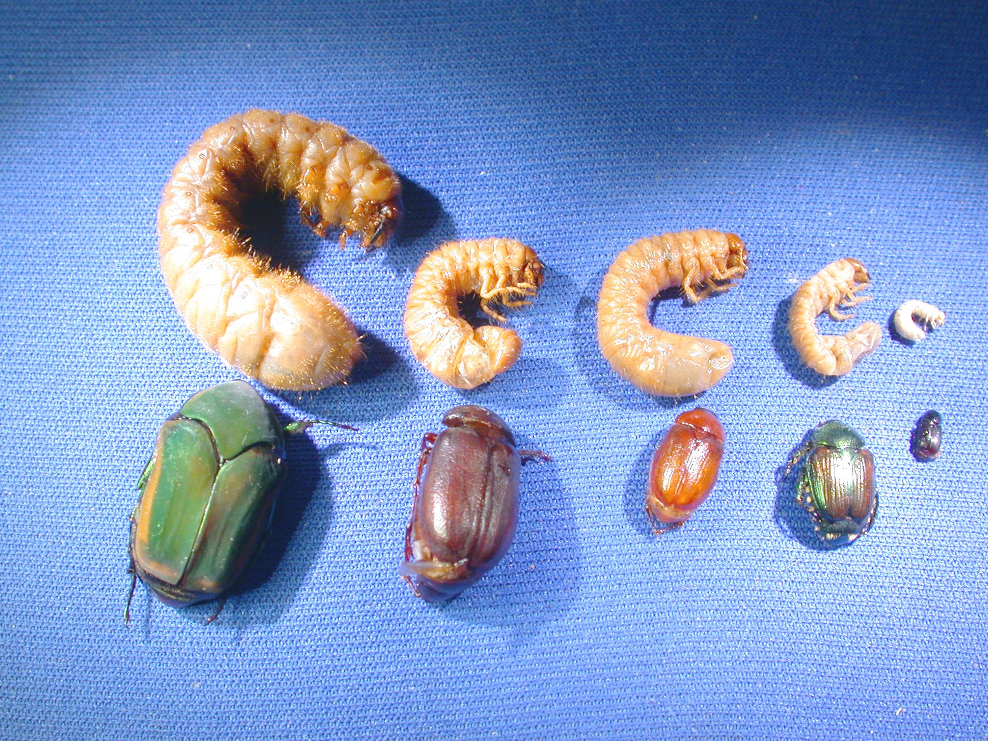
Variety of White Grubs
Green June May/June Chafer Japanese Ataenius Beetle Beetle Beetle

Slide 4
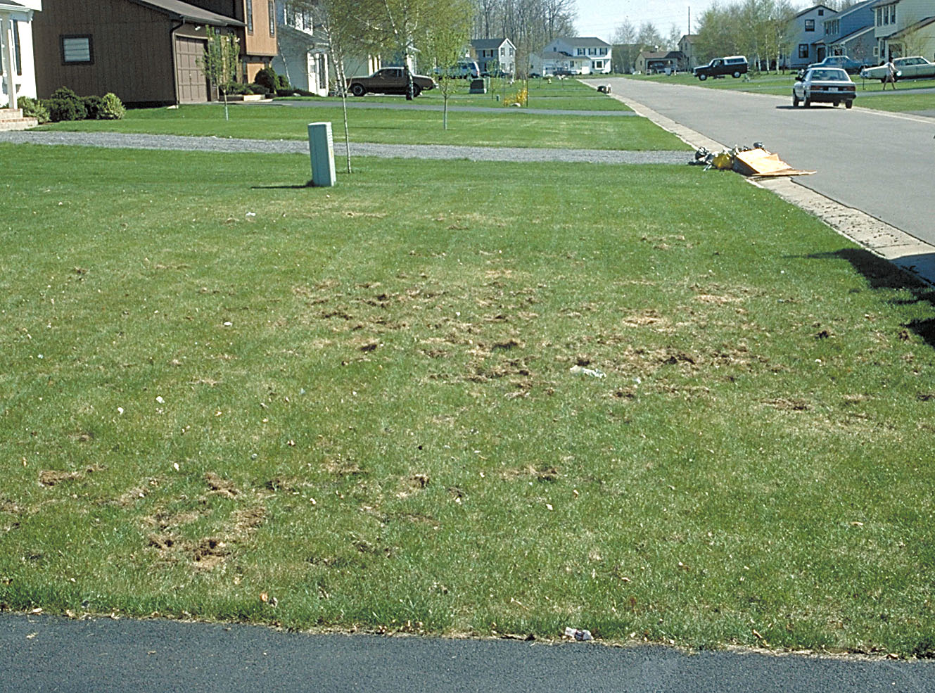
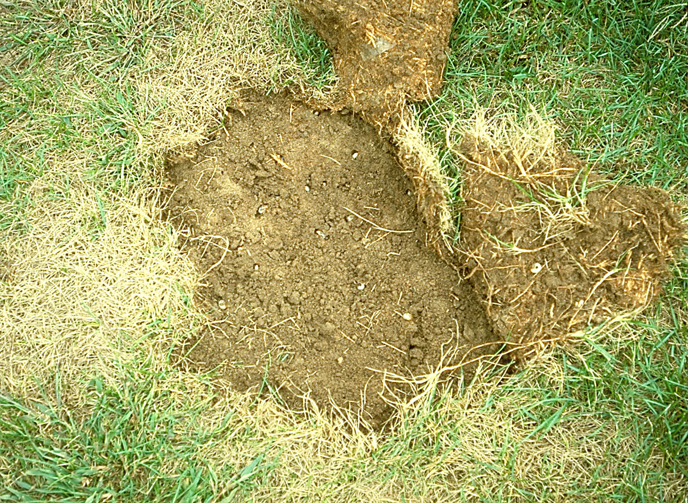
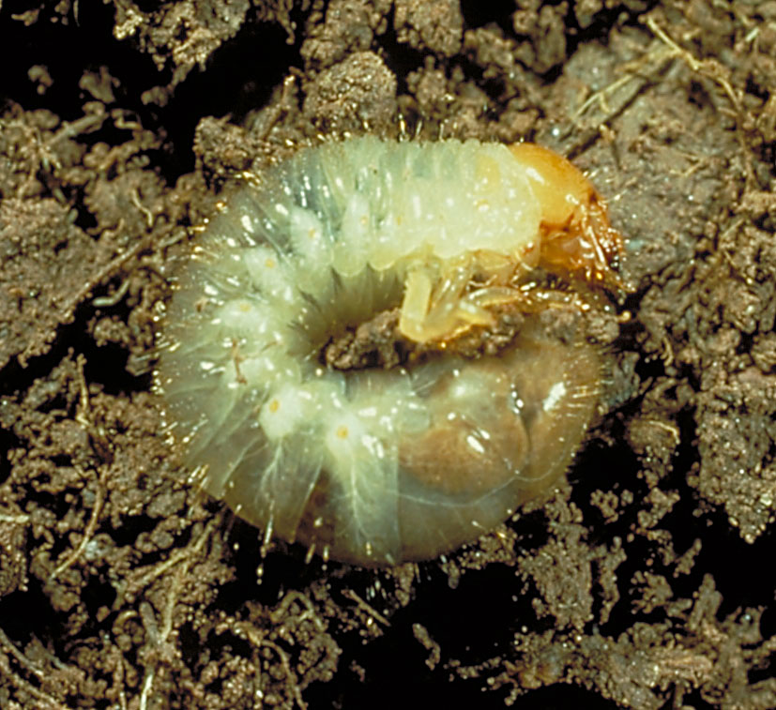
White Grub Damage

Slide 5
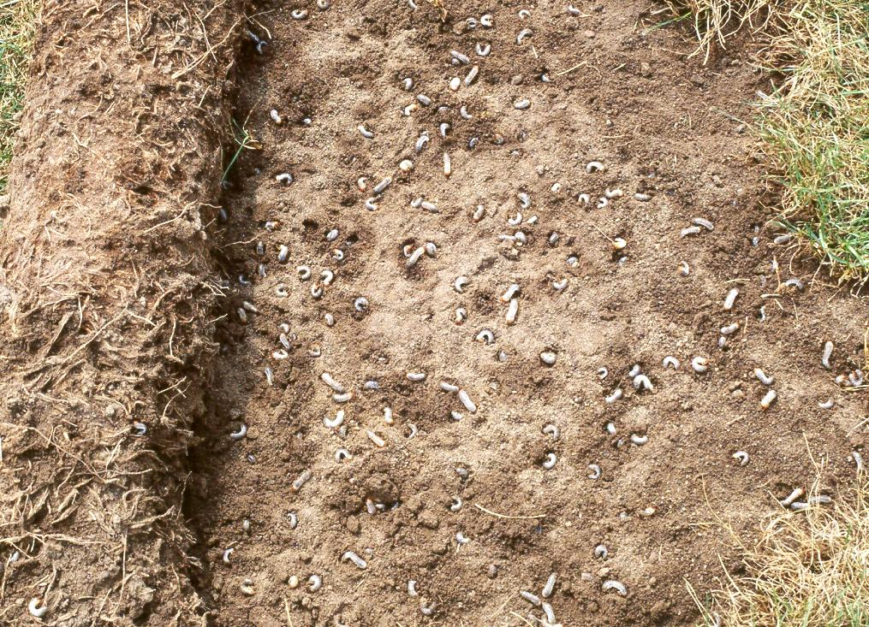

Slide 6
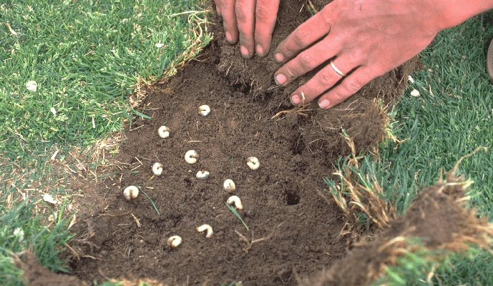
Grub Evidence Under Sod

Slide 7
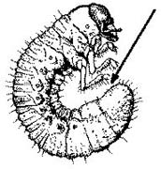
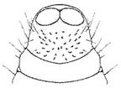

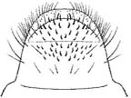
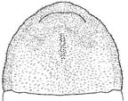
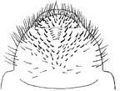
White Grub Rasters
Black Turfgrass Ataenius
May/June Beetle
Masked Chafer
Green June Beetle
Japanese Beetle

Slide 8
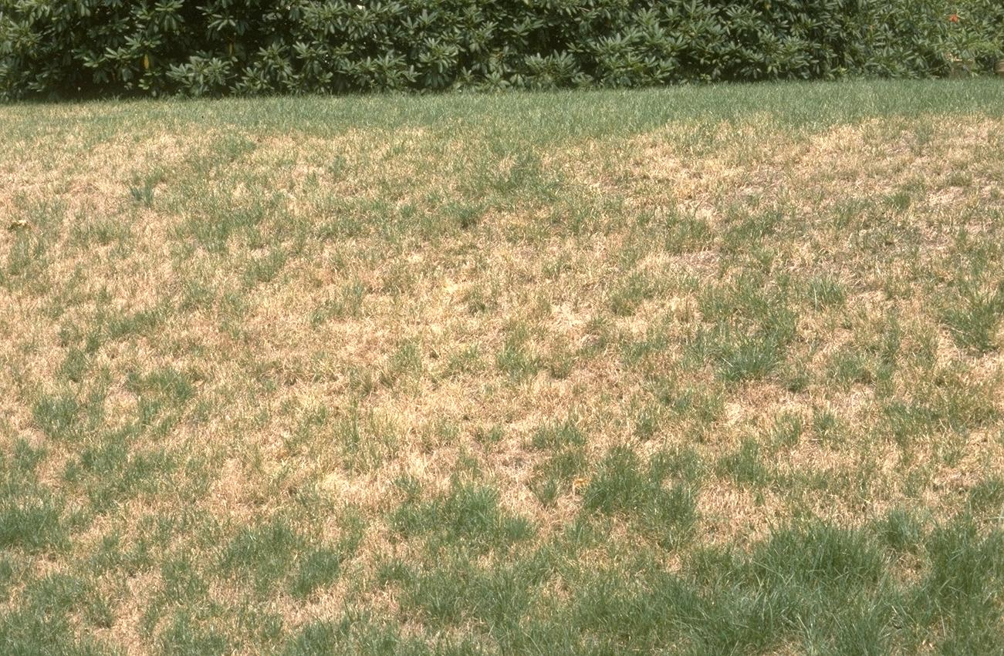
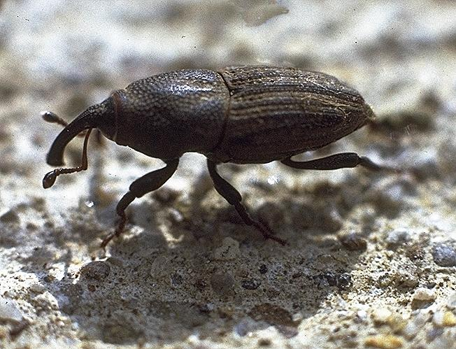
Billbug damage to lawn – can look like drought
© HDN
Billbugs are weevils and have a prominent snout
Bluegrass billbug adult
on sidewalk
© HDN

Slide 9
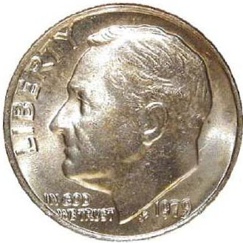
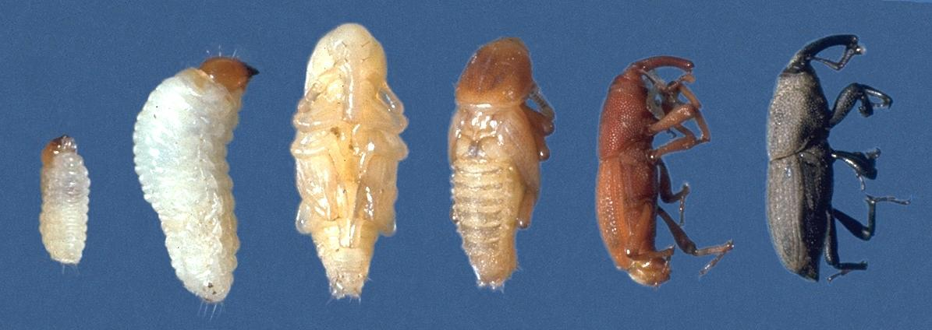
Bluegrass Billbug Life Stages
They are very small!!
© HDN
small larva mature larva fresh pupa mature pupa callow adult mature adult
Adult color can be gray to black

Slide 10
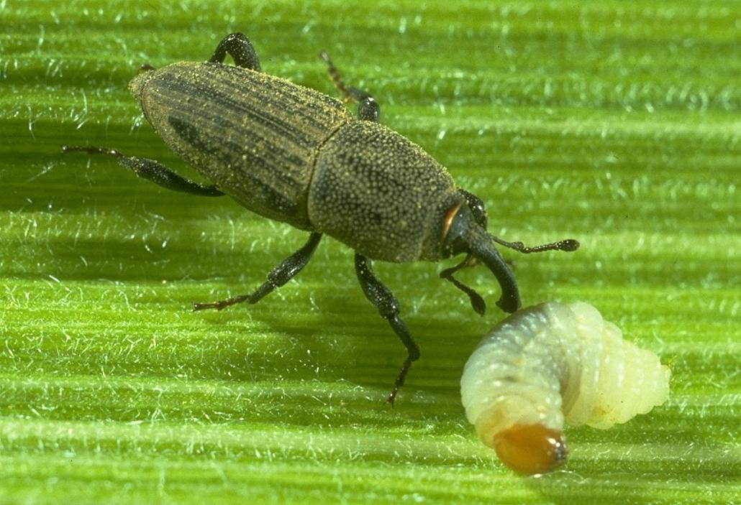
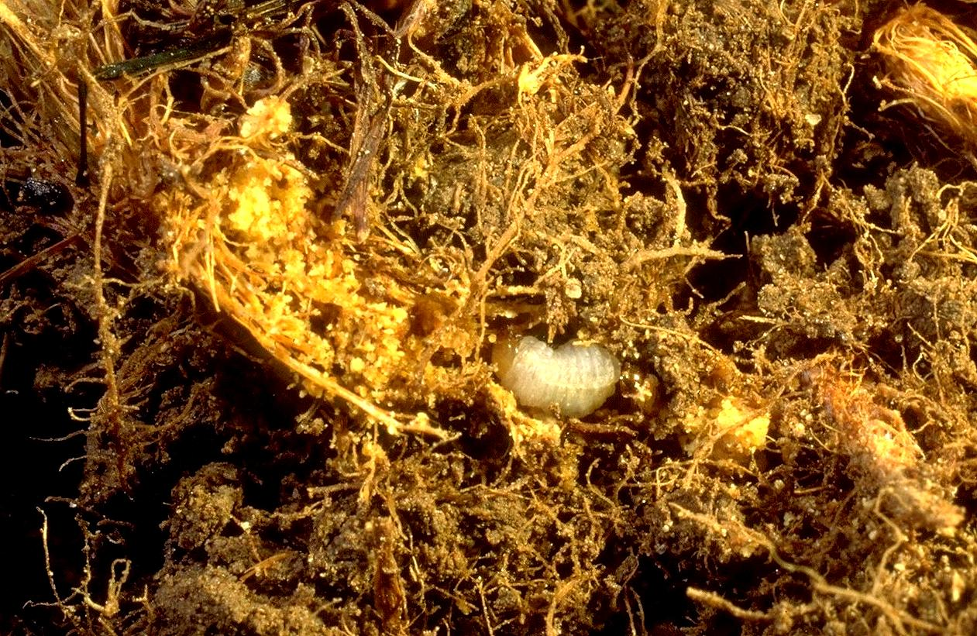
Bluegrass Billbug
Adult and larva
Larva feeding on crown

Slide 11
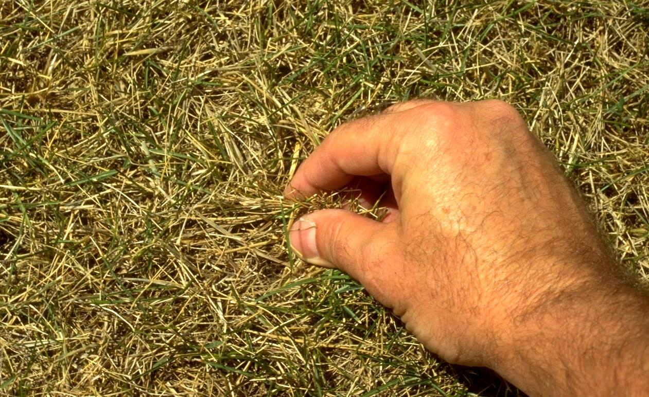
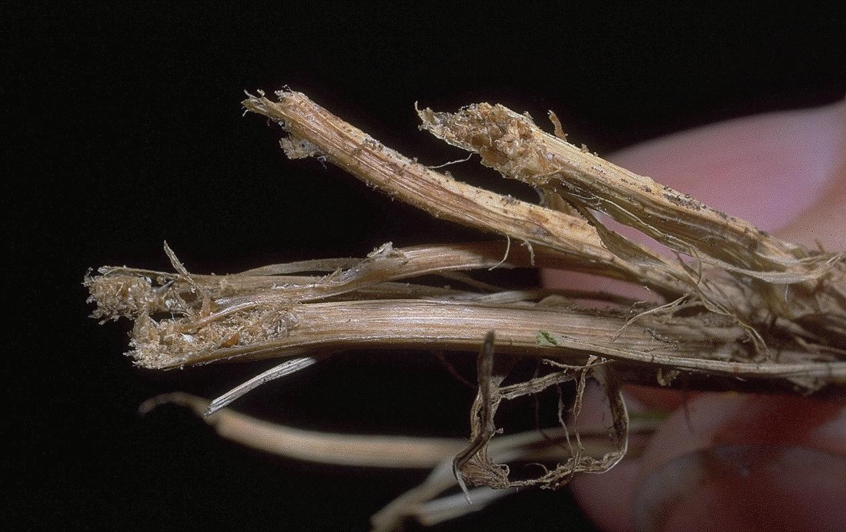
The “Tug Test”
Frass – sawdust-like material

Slide 12
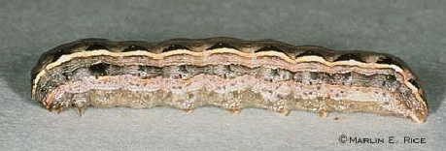
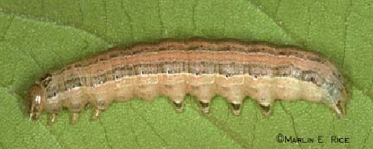
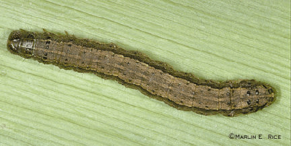
Armyworm species of turf
Yellow Striped Armyworm
True Armyworm
Fall Armyworm

Slide 13
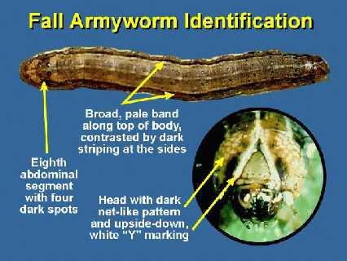
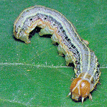

Identifying Armyworm Larvae
Inverted Y on
front of head

Slide 14
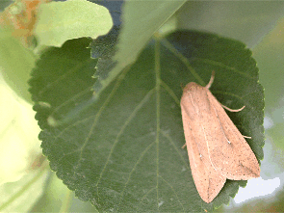
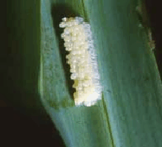
True Armyworm
Adult
Egg mass on grass leaf

Slide 15
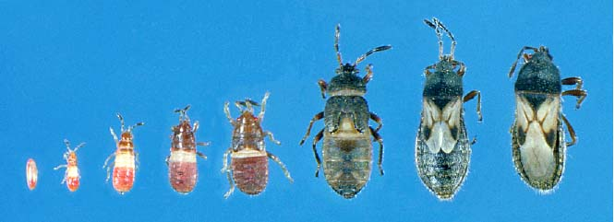
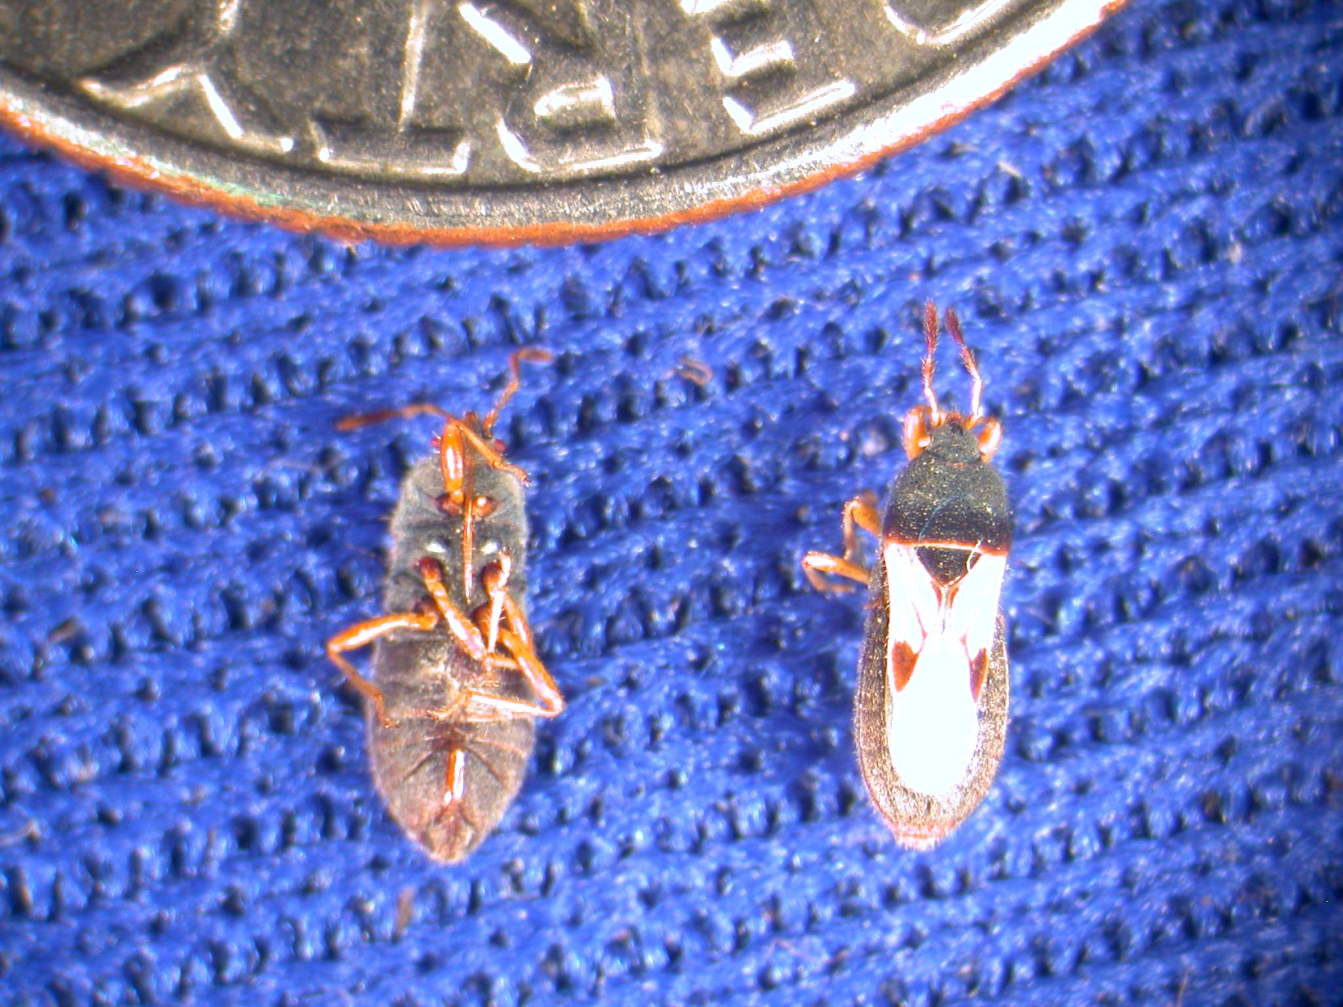
Common Chinch Bug
Stages of development

Slide 16
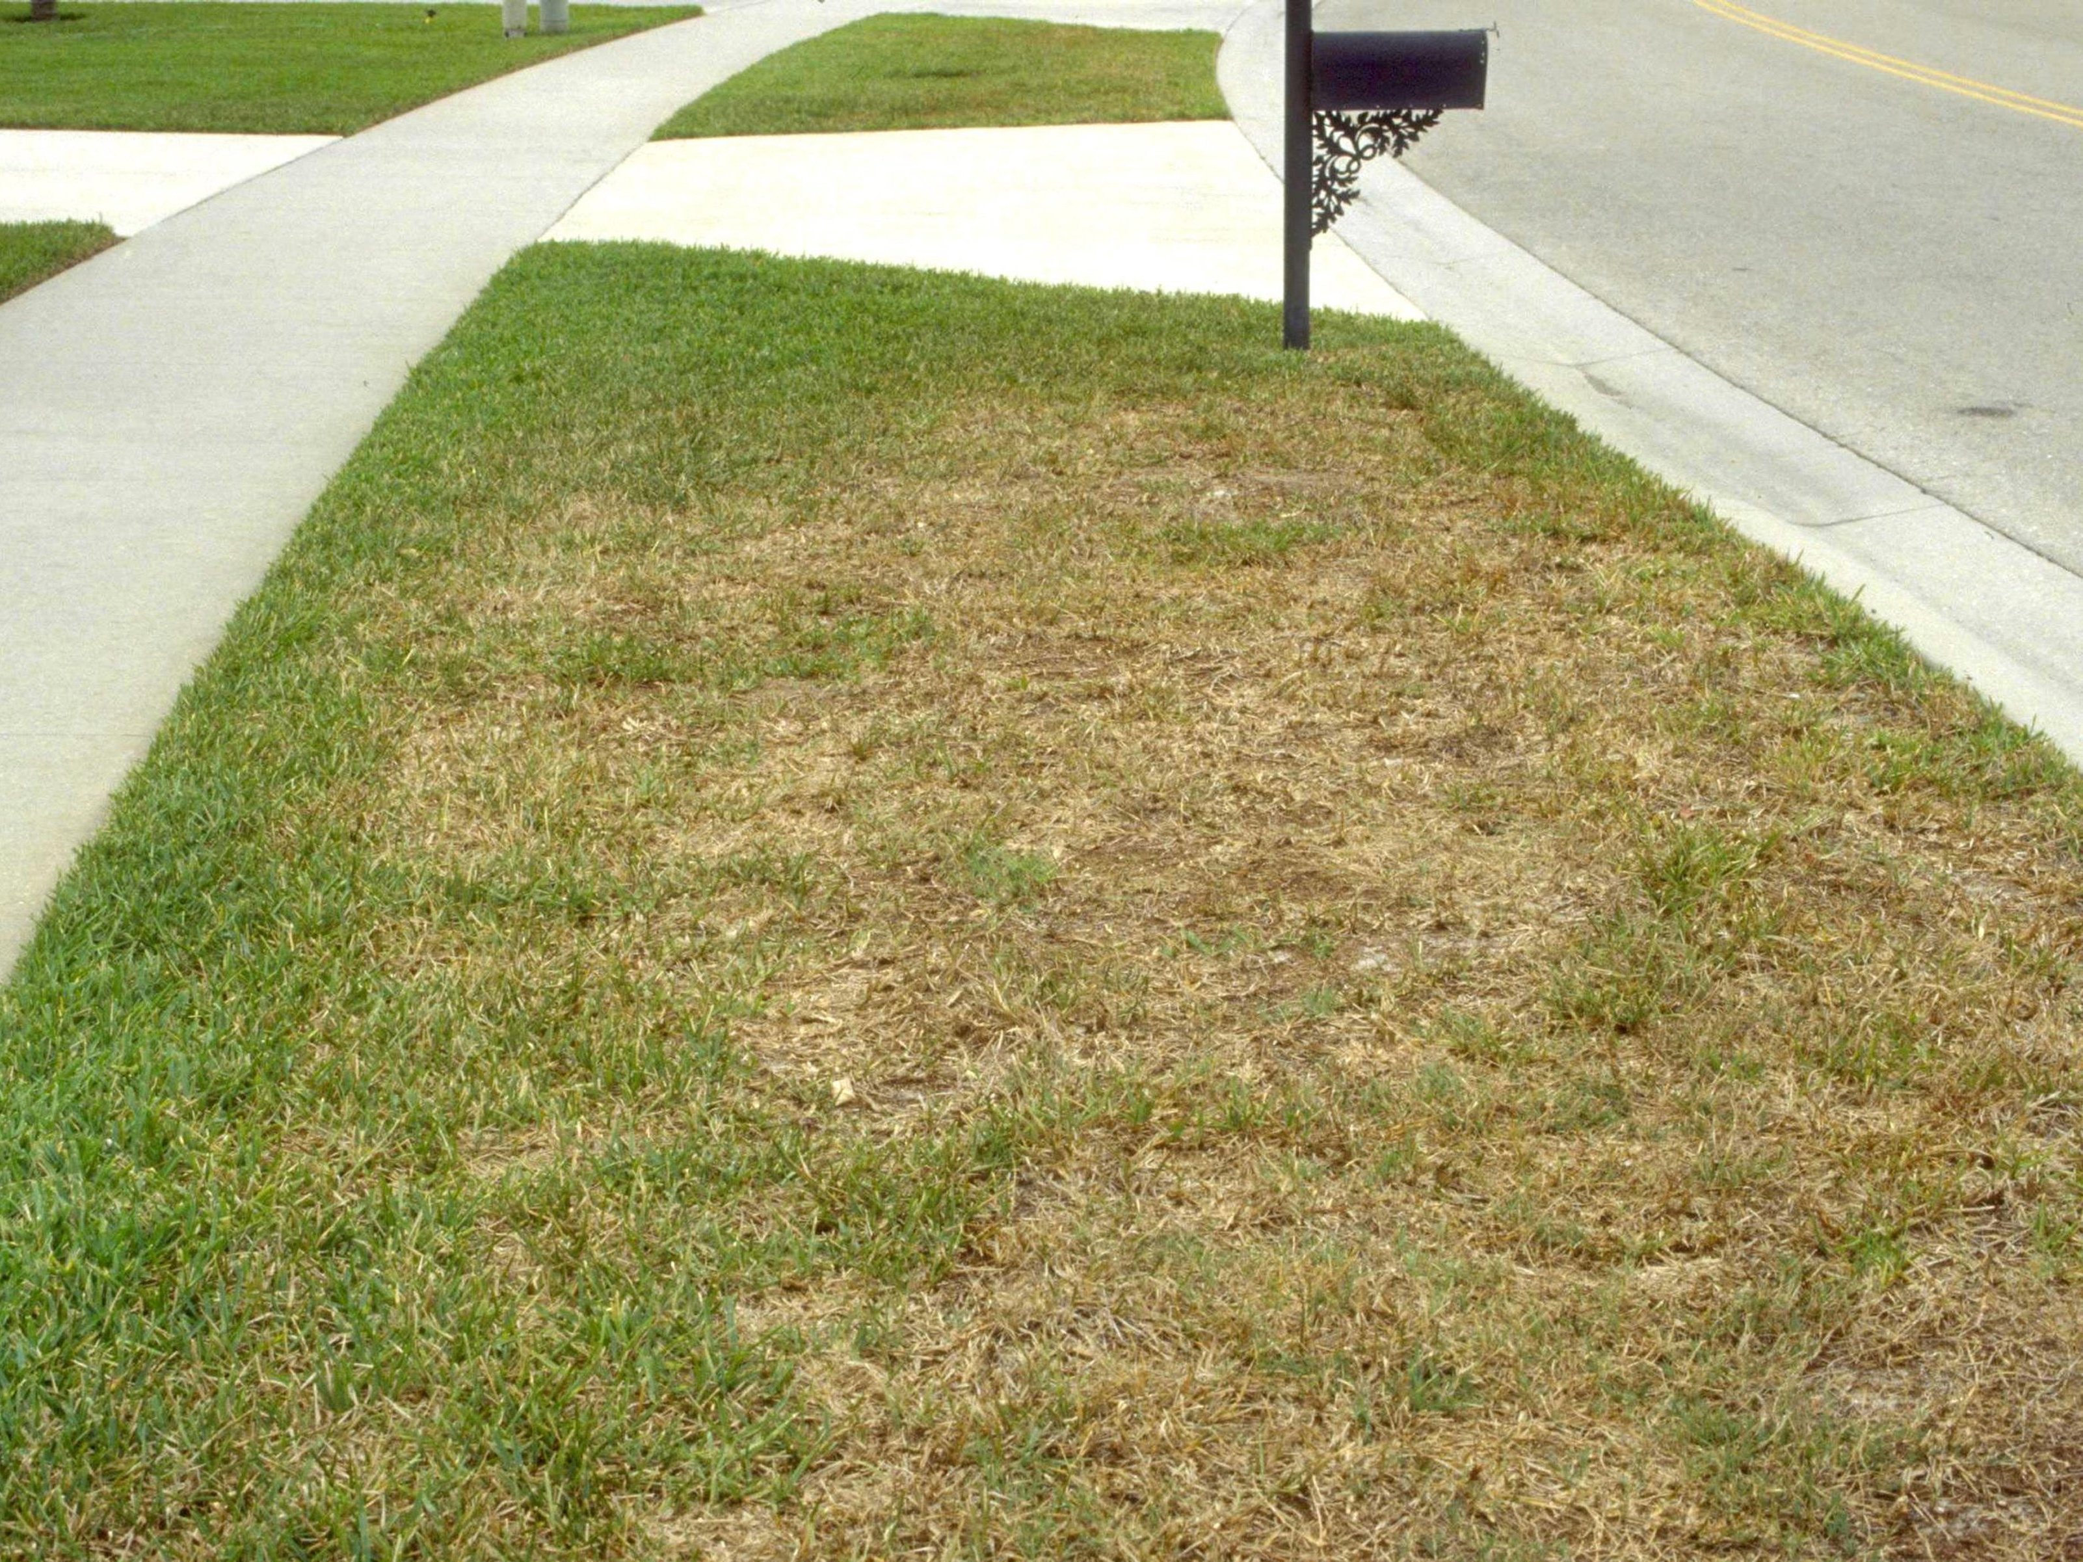
Chinch bug damage is often confused with drought stress

Slide 17
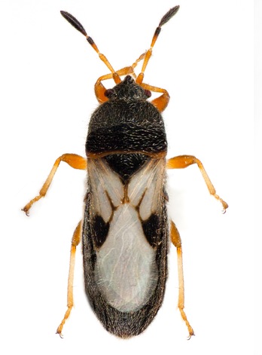
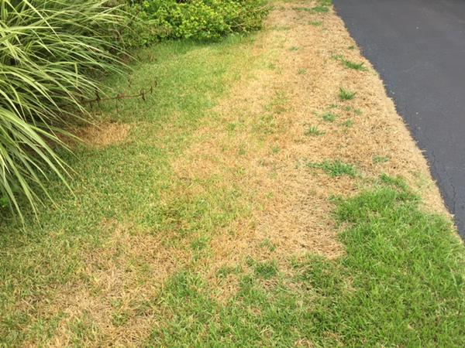
Chinch bugs have sucking mouth parts and will interfere with water movement through the plant
Damage on St. Augustine

Slide 18
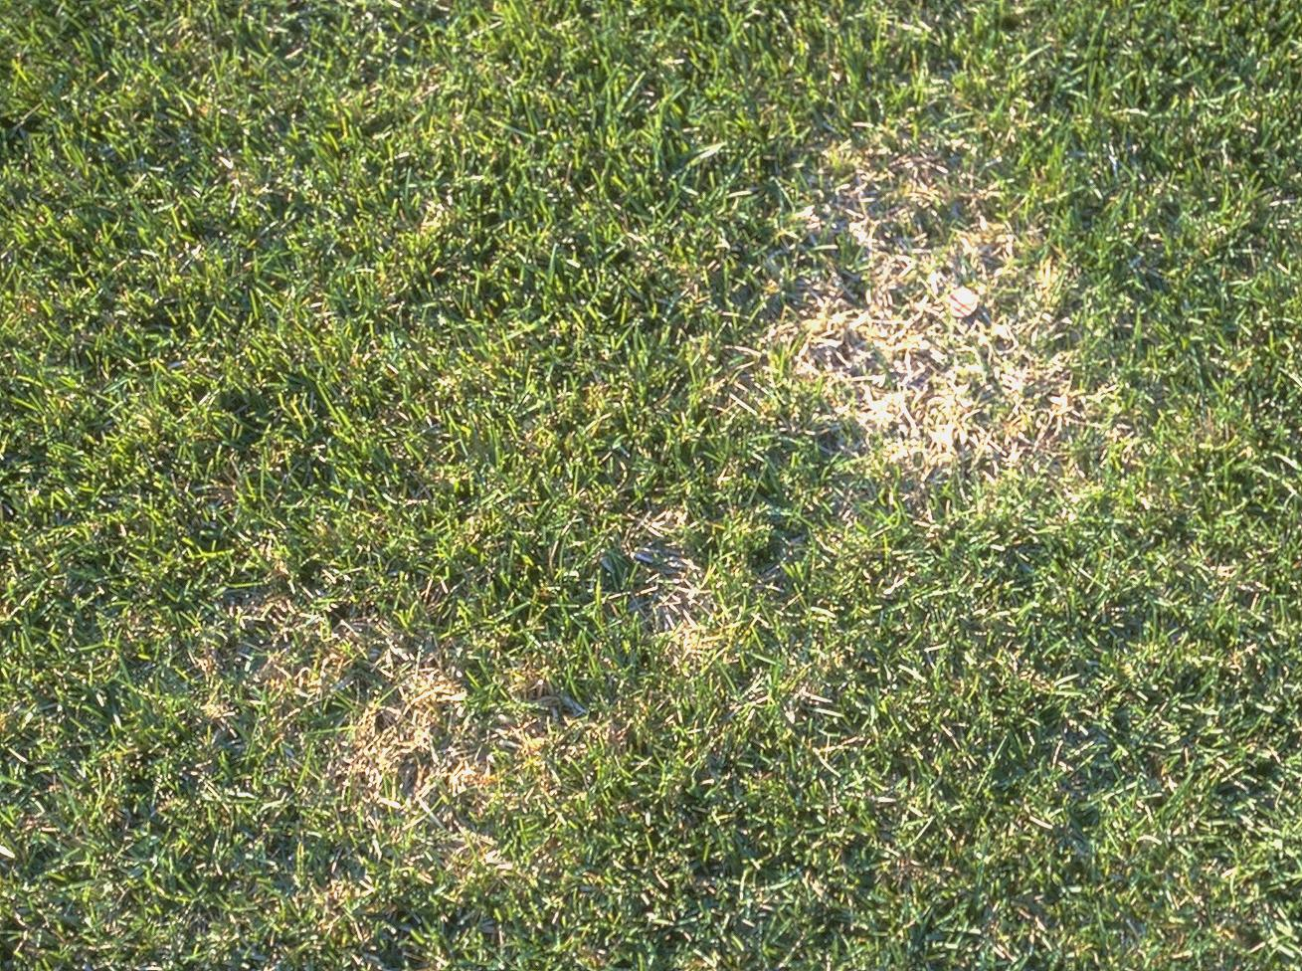
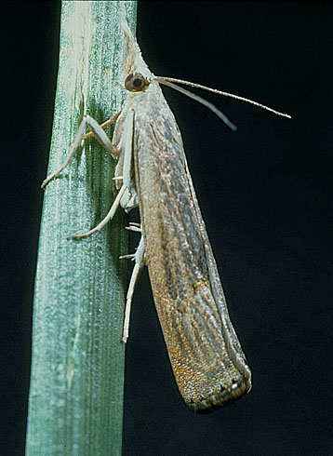
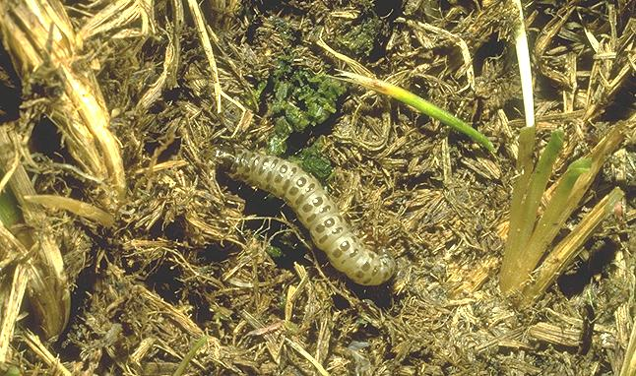
Sod Webworms
Spring damage
Adult bluegrass webworm
Larva and frass

Slide 19
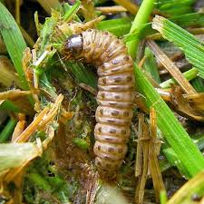
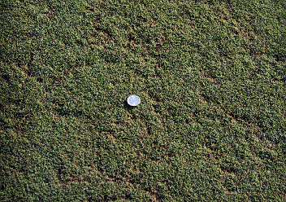
Sod Webworm Damage on Bentgrass
Damage pattern looks like “trails”

Slide 20
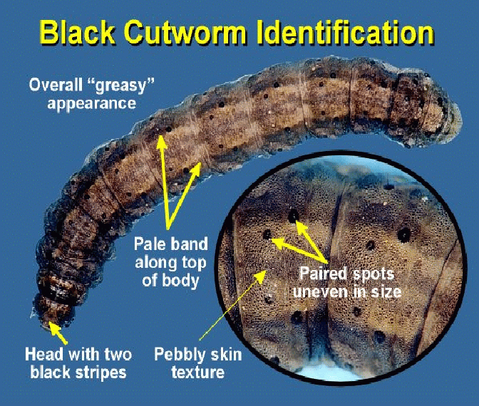
Black Cutworms

Slide 21
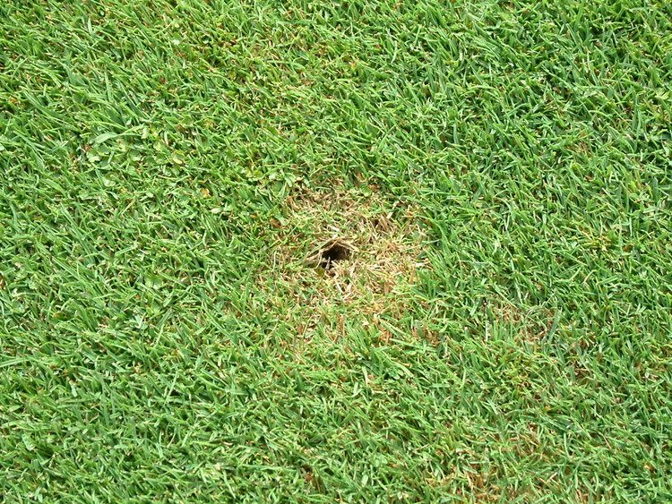
Black cutworms will have a distinct burrow and feed on leaves close by

Slide 22
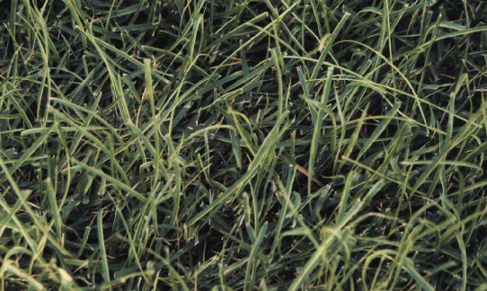
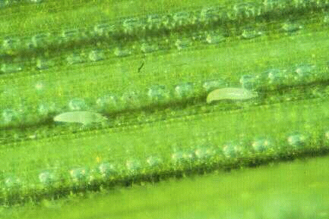
Zoysiagrass mite
Mite damage on a zoysiagrass lawn

Slide 23
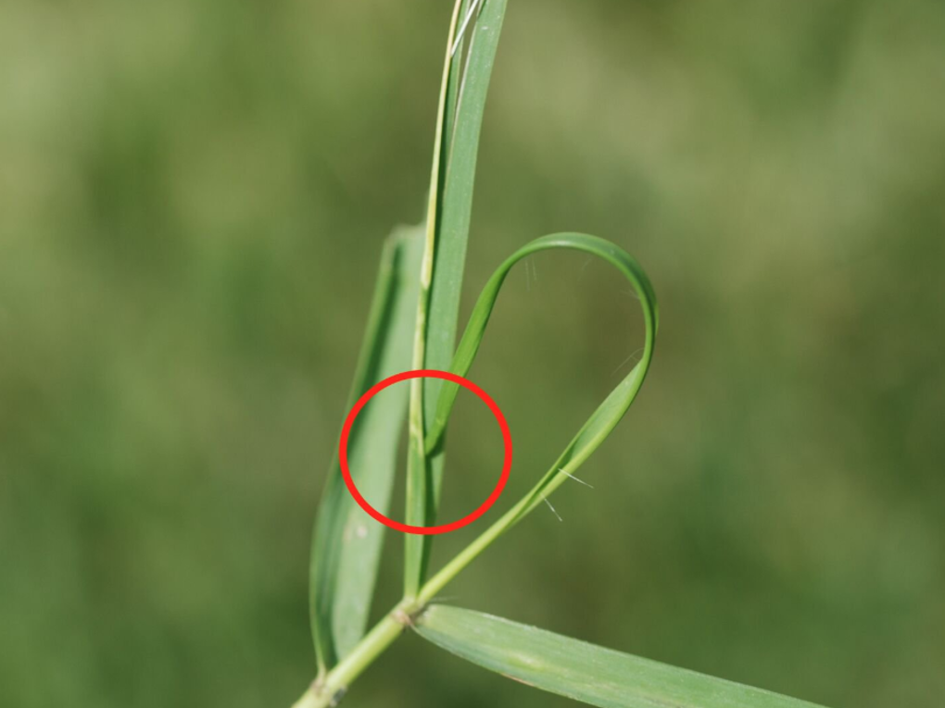
Zoysiagrass mite damage -
New leaf can’t emerge, causing a “buggy whip”

Slide 24
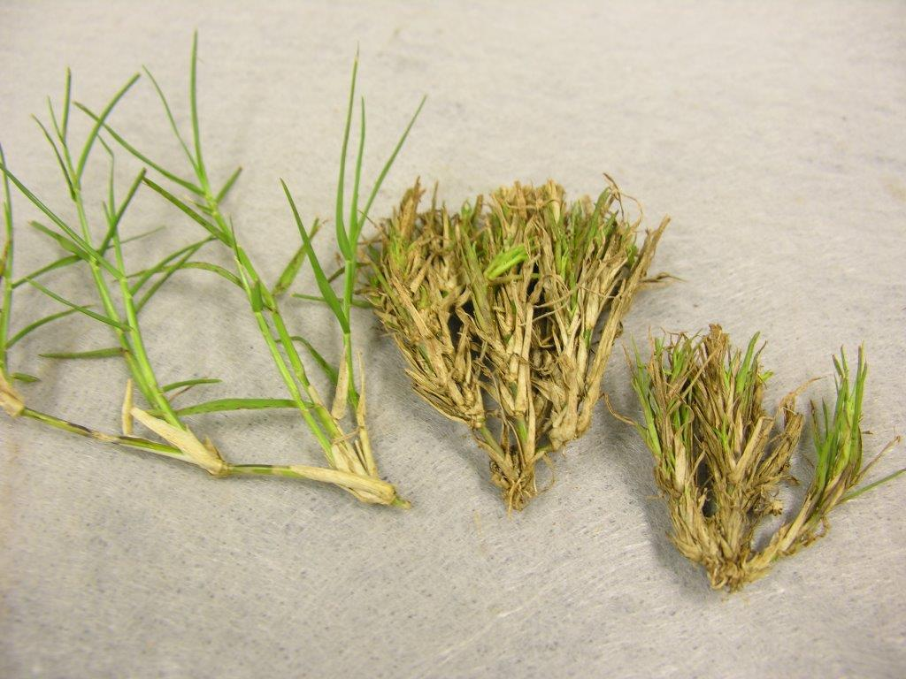
“Witch’s broom”
Mite damage on bermudagrass

Slide 25
