Slide 1
Weeds
Annual Bluegrass
Annual Sedge
Barnyardgrass
Bedstraw/Catchweed
Bermudagrass
Black Medic
Broadleaf Dock
Broadleaf Plantain
Buckhorn Plantain
Bull Thistle
Canada Thistle
Carpetweed
Chicory
Cinquefoil
Common Chickweed
Common Mallow
Common Mullien
Common Vetch
Crabgrass (Smooth)
Creeping Bentgrass
Creeping Buttercup
Creeping Speedwell
Curly Dock
Dallisgrass
Dandelion
Dollarweed/Pennywort
English Daisy
Evening Primrose
Fall Panicum
Field Bindweed
Field Pansy
Geranium
Goosegrass
Green Foxtail
Ground Ivy
Groundsel
Hairy Bittercress
Hairy Buttercup
Hairy Galinsoga
Hawkweed
Healall
Henbit
Indian Mock Strawberry
Japanese Stiltgrass
Kikuyugrass
Lambsquarter
Lespedeza
Marestail
Morning Glory
Mouse Ear Chickweed
Mustard
Nimblewill
Orchardgrass
Oxeye Daisy
Pennsylvania Smartweed
Peppergrass/Virginia Pepperweed
Prickly Lettuce
Prostrate Knotweed
Prostrate Spurge
Purple Nutsedge
Purslane
Quackgrass
Ragweed
Red Sorrel
Sandbur
Shepard's Purse
Spotted Spurge
Sow Thistle
Star of Bethlehem
Thymeleaf Speedwell
Venice Mallow
Violet
Virginia Buttonweed
Western Salsify
White Clover
Wild Carrot
Wild Strawberry
Wild Violet
Yarrow
Yellow Foxtail
Yellow Nutsedge
Yellow Rocket
Yellow Woodsorrel/Oxalis

Slide 2
Weeds
Grasses

Slide 3
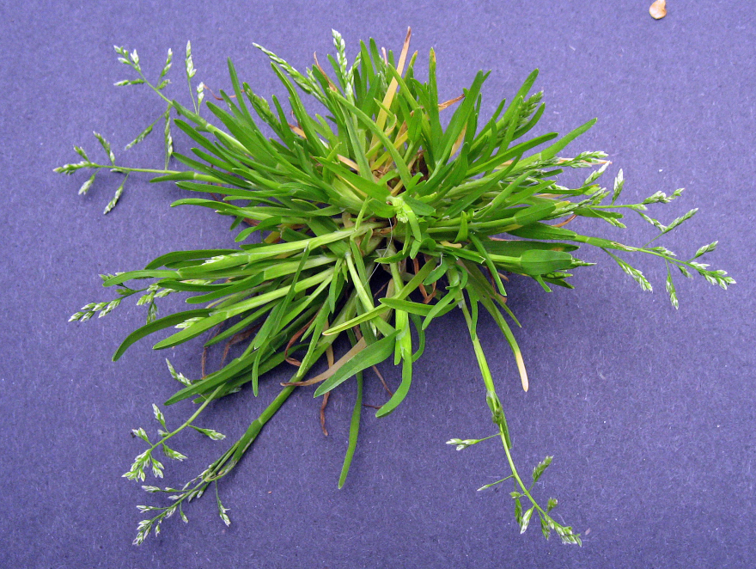
annual bluegrass
(Poa annua)

Slide 4
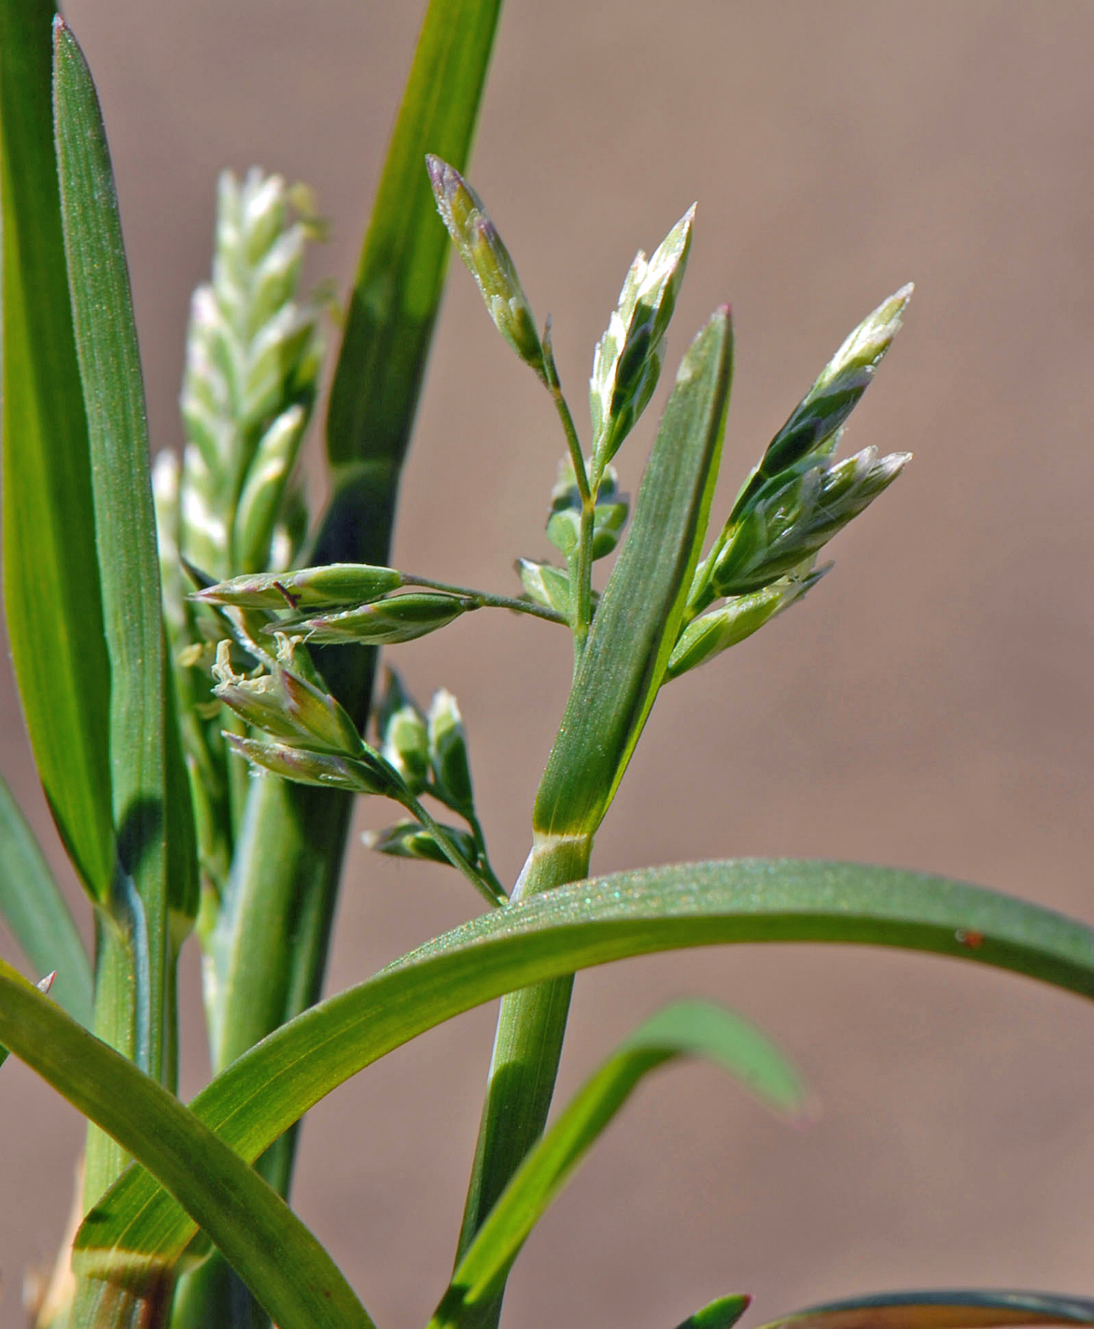
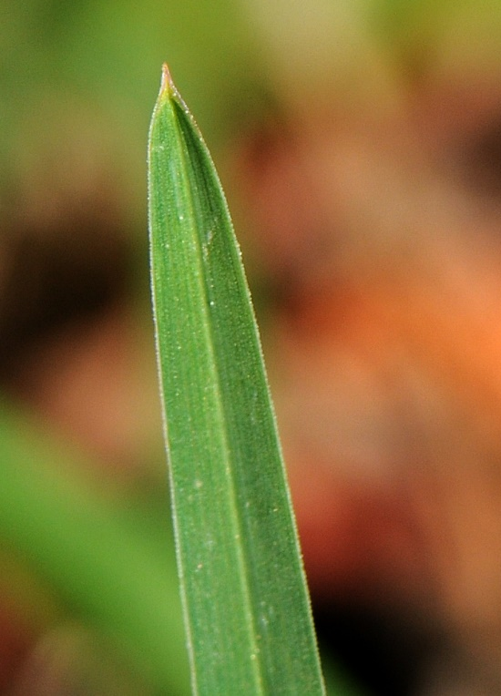
annual bluegrass
Boat shaped leaf tip
Winter annual
Prolific seed producer

Slide 5
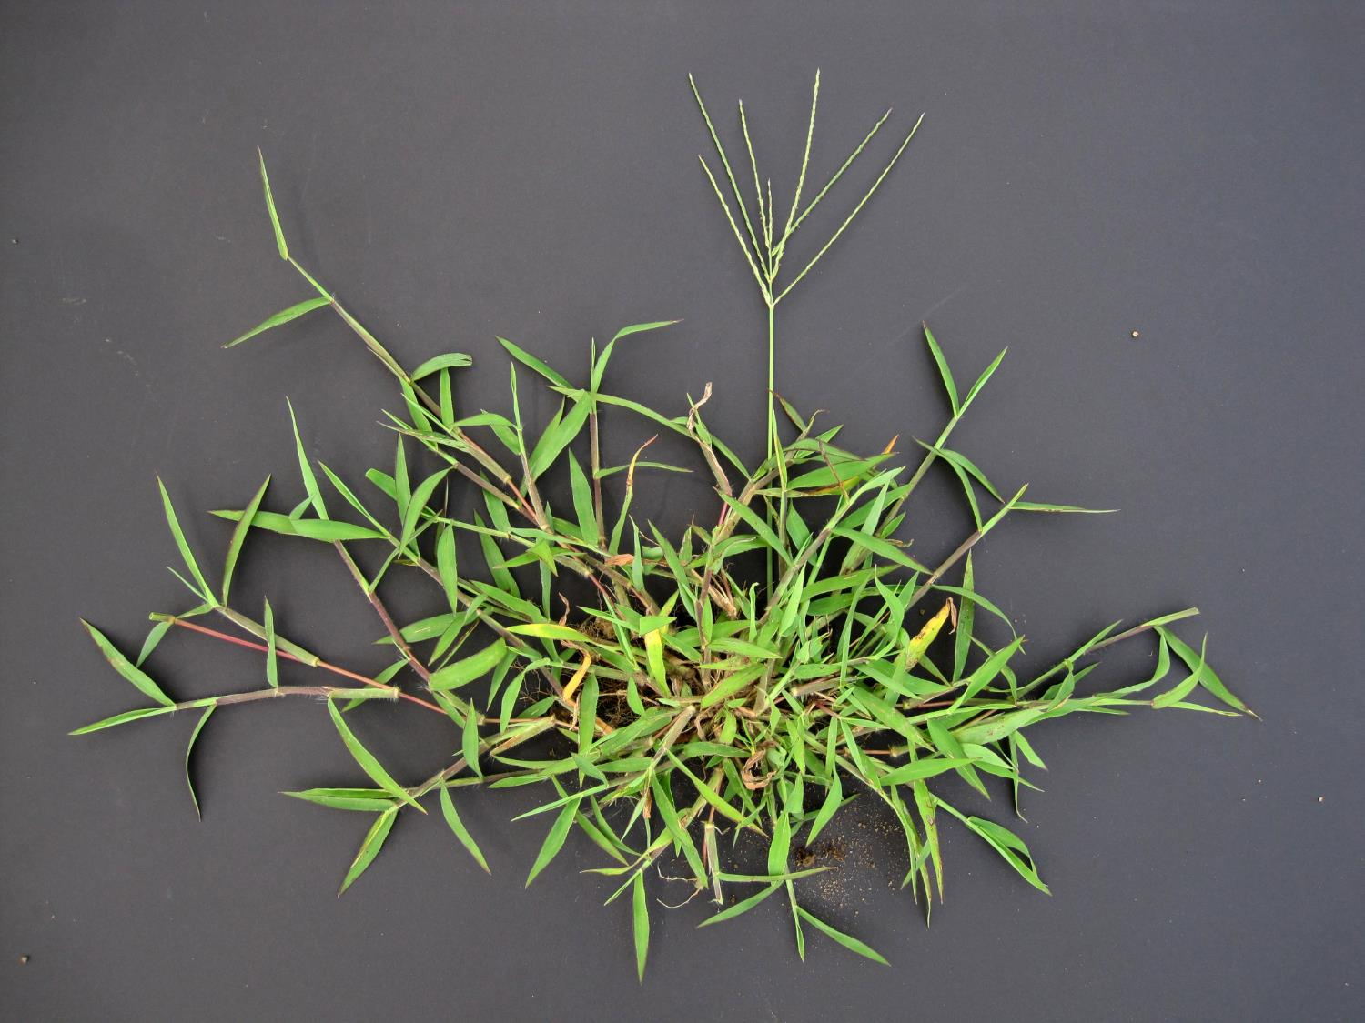
Crabgrass (Digitaria sanguinalis)

Slide 6
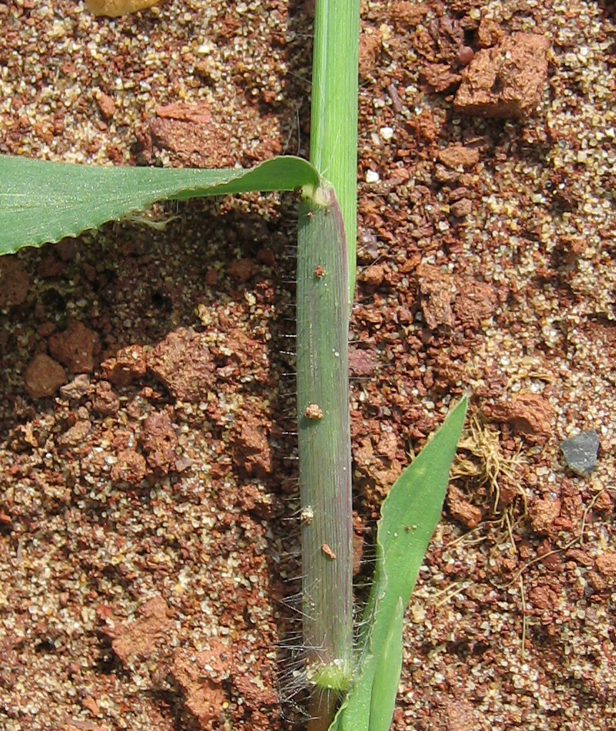
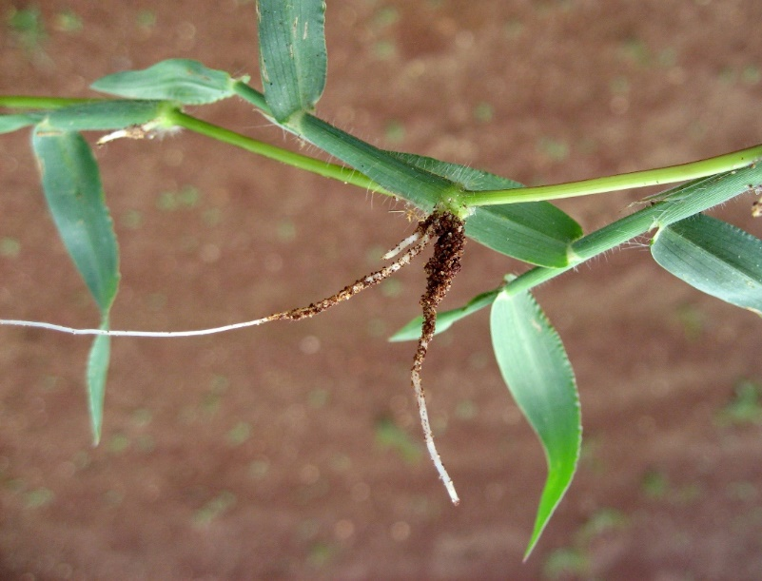
crabgrass
Leaf sheath and blade hairy
Auricles – absent
Roots at nodes

Slide 7
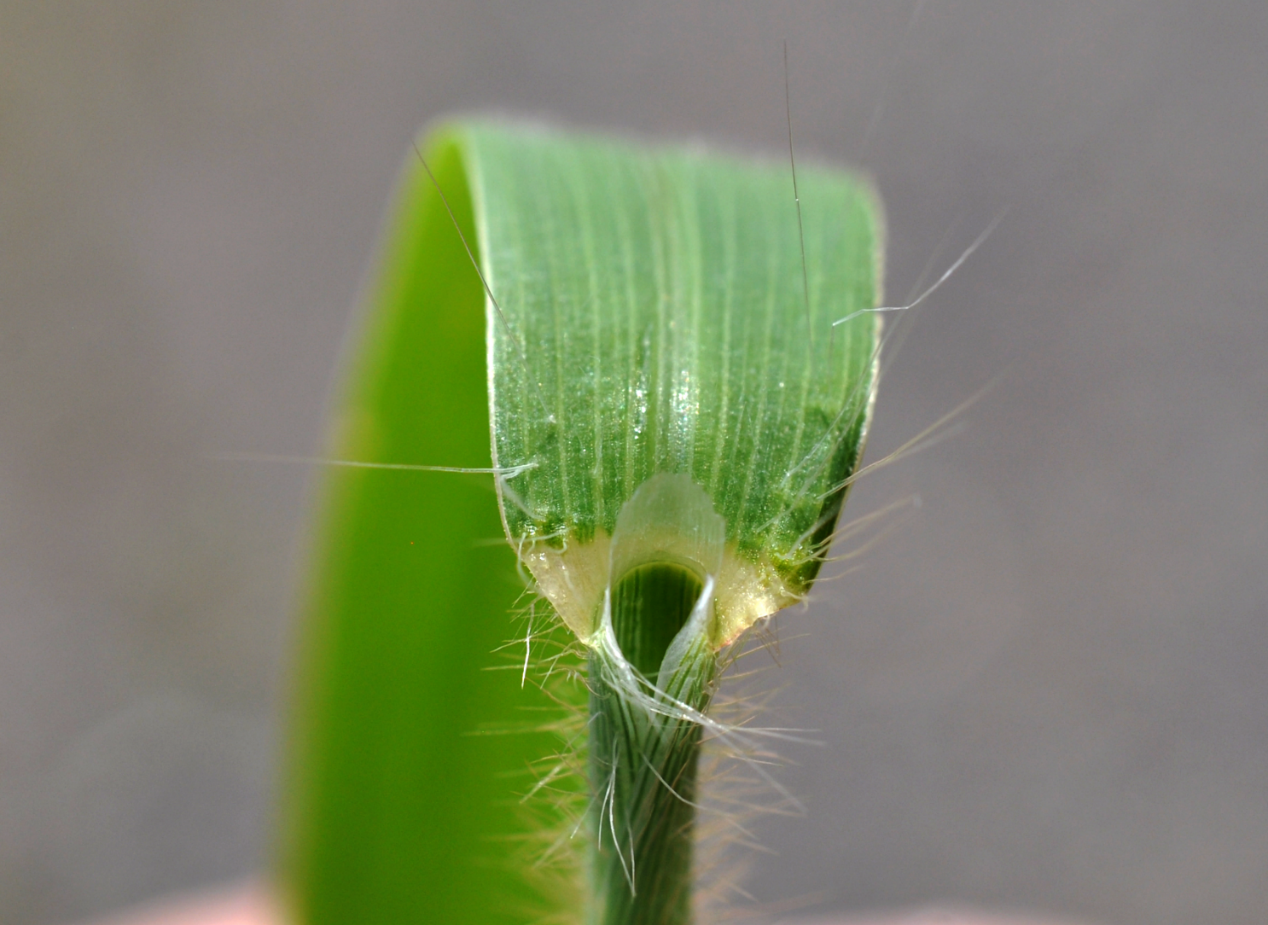
Crabgrass ligule is membranous

Slide 8
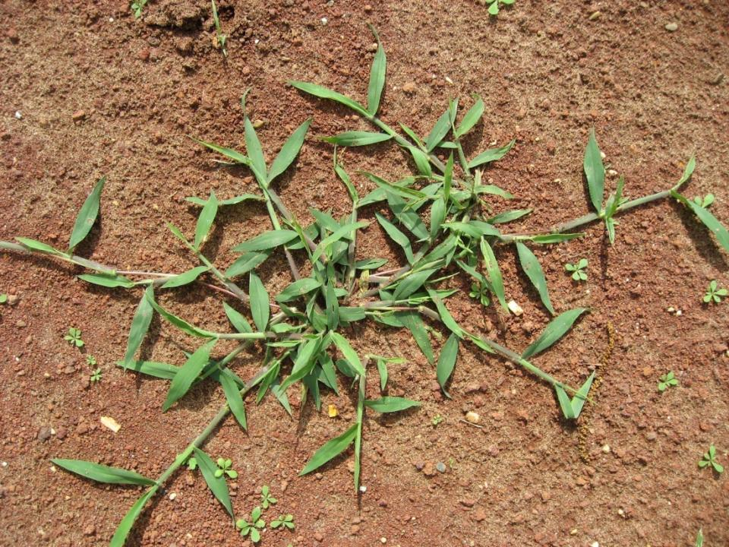
Large crabgrass sends out runners which root at the nodes.

Slide 9
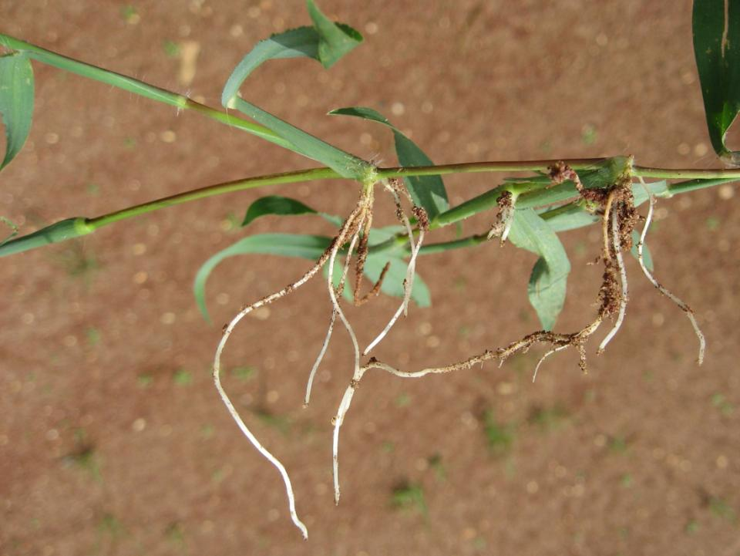
Roots emerging from a crabgrass runner

Slide 10
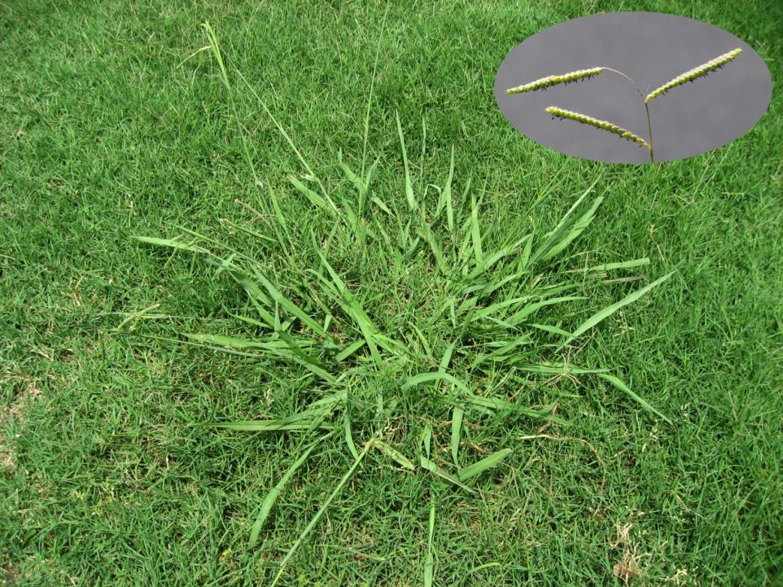
Dallisgrass (Paspalum dilatum)

Slide 11
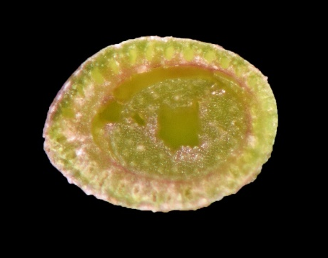
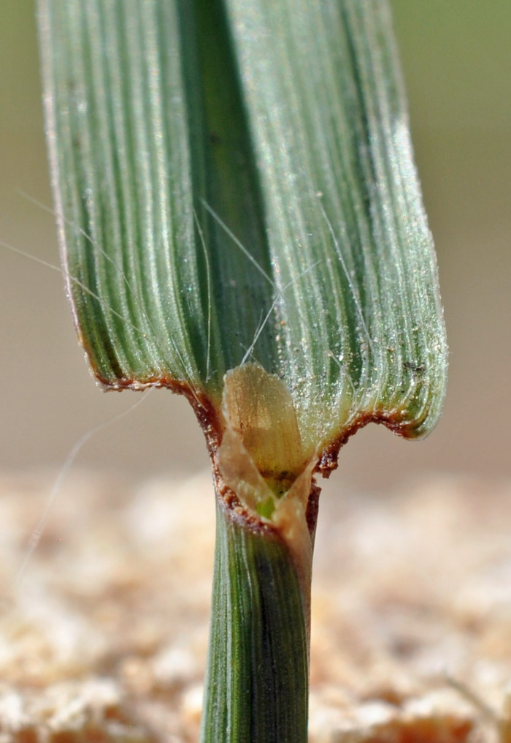
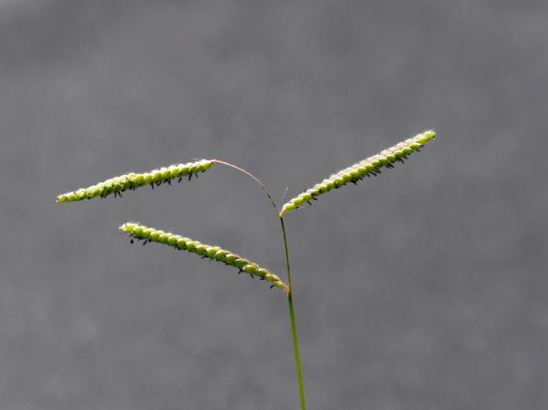
Dallisgrass

Slide 12
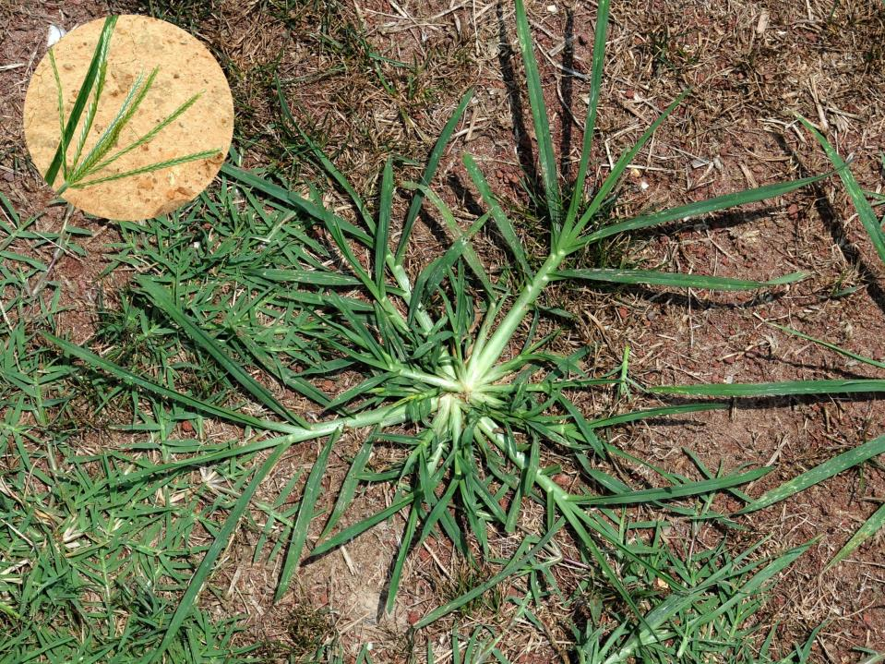
Goosegrass (Eleusine indica)

Slide 13
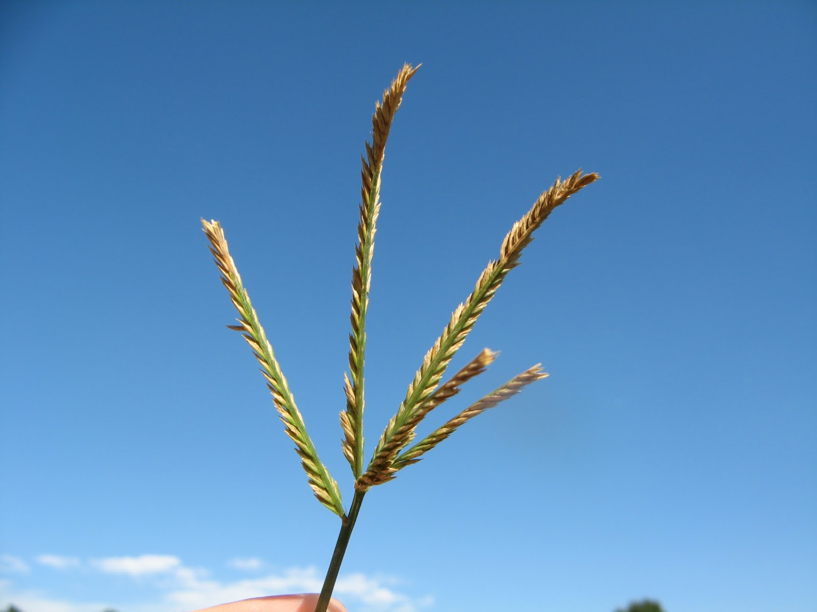
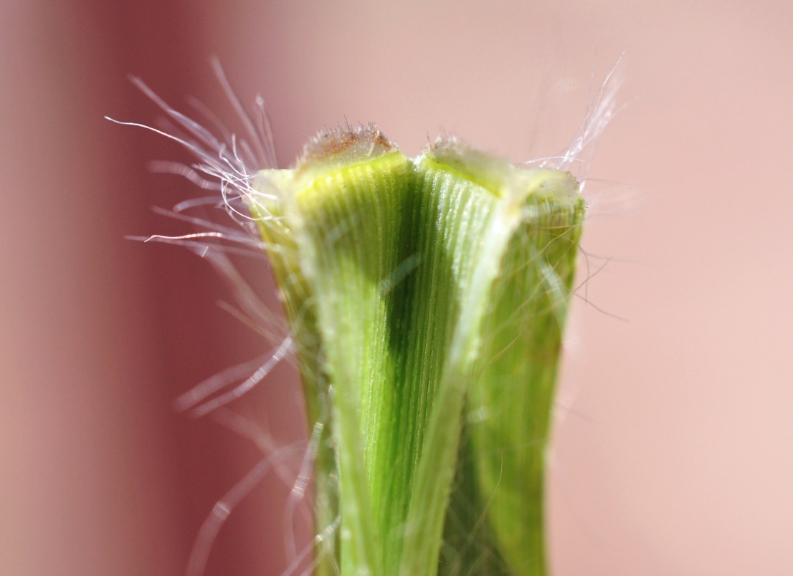
Goosegrass
First leaf obviously ribbed with veins, and dark green lines.
Basal stem silver.
Leaf sheath - light green or white.
Ligule - very short, ciliated membrane.
Long hairs on leaf base.
Auricles - absent.
Goosegrass ligule

Slide 14
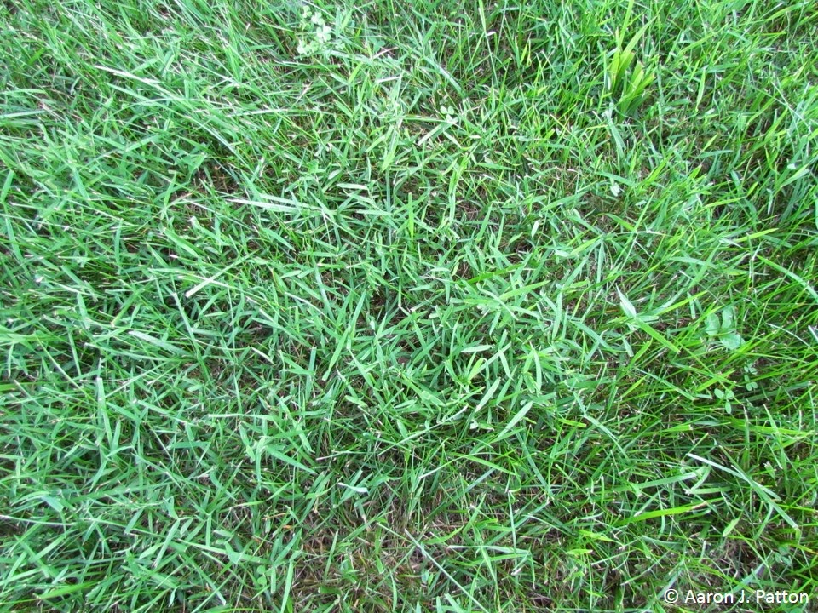
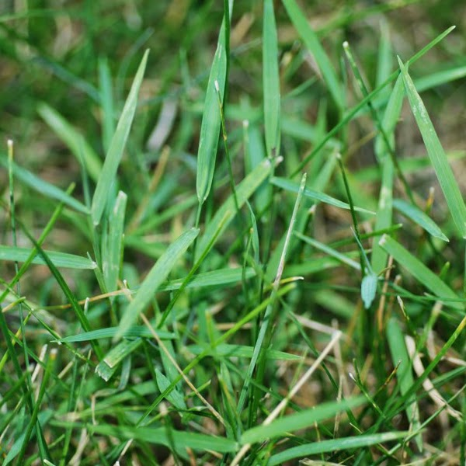
Nimblewill (Muhlenbergia schreberi)
Summer perennial grass
Often confused with bermudagrass
Often found in shaded areas

Slide 15
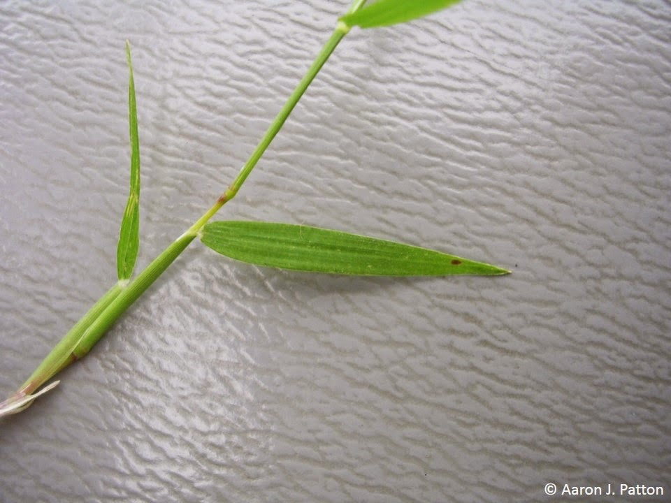
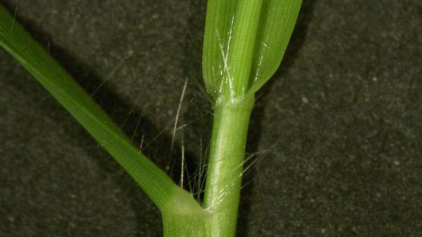
Nimblewill
Short leaf blades with very pointed leaf tip

Slide 16
Weeds
Broadleaf (dicots)

Slide 17
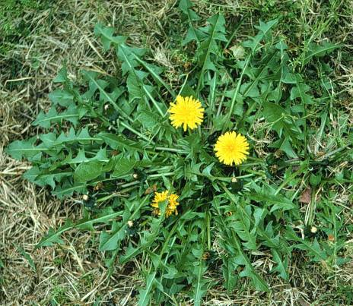
Dandelion
Hardy perennial with thick, fleshy taproot
No stem
Leaves grow in a rosette from the crown
Leaves long, narrow with irregular lobes pointing toward the crown
Leaves purplish at base and emit milky substance when broken

Slide 18
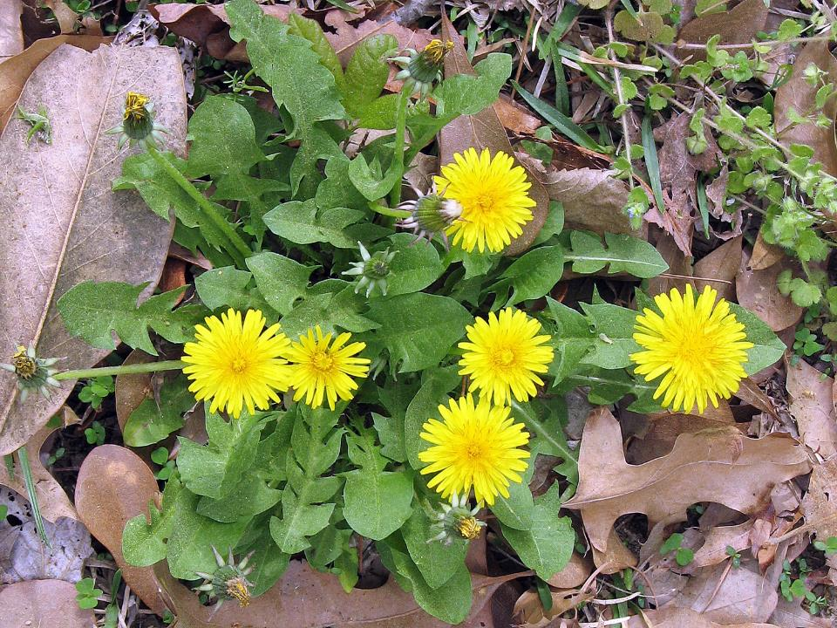
Dandelion

Slide 19
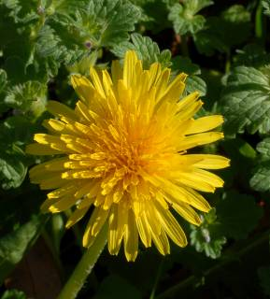
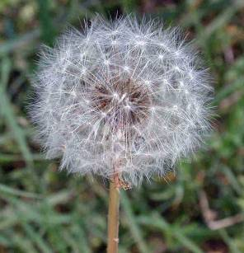
Dandelion
Deep golden yellow flowers on heads of long hollow stalks
Blossoms mature into spherical clusters of whitish fruits (puffballs) made of parachute-like seeds spread easily by wind

Slide 20
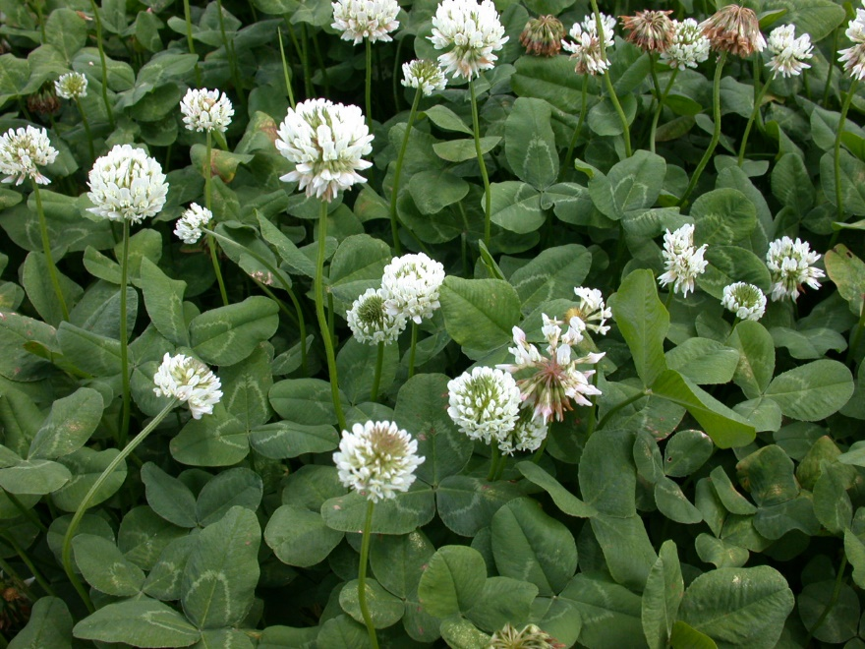
White Clover

Slide 21
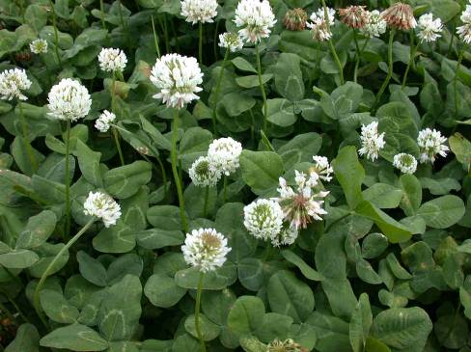
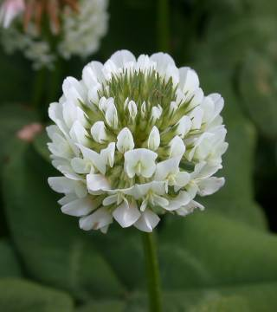
White Clover
Perennial with creeping stems that root at the nodes
Trifoliate leaves on long petioles surrounded at base by membranous sheath
Leaves usually with white crescent-shaped water marks
White to pink flowering heads on long stalks, 0.5 to 1.5 inches in diameter

Slide 22
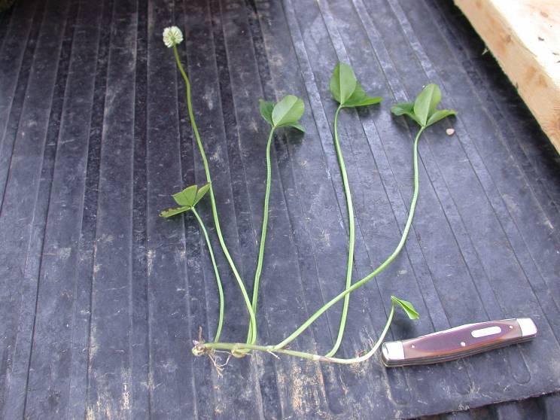
White Clover
Perennial with creeping stems that root at the nodes

Slide 23
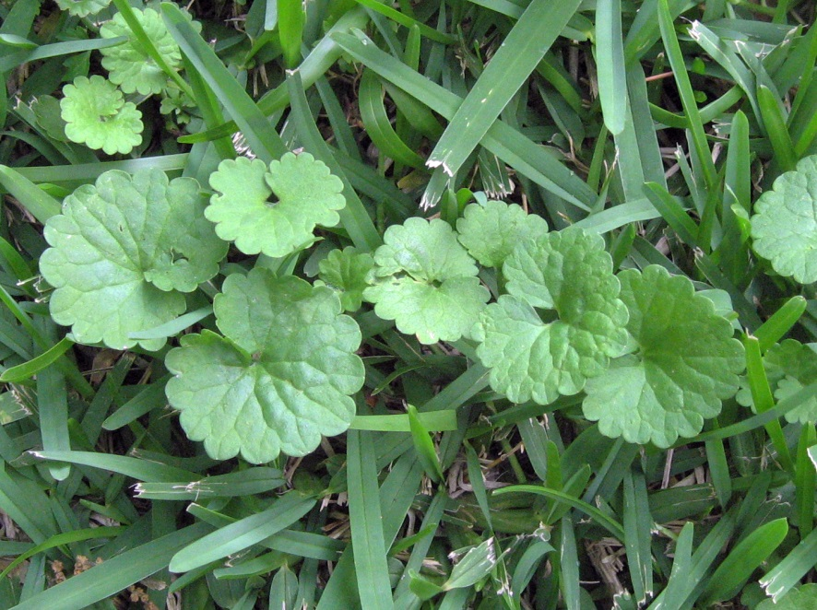
Ground Ivy

Slide 24
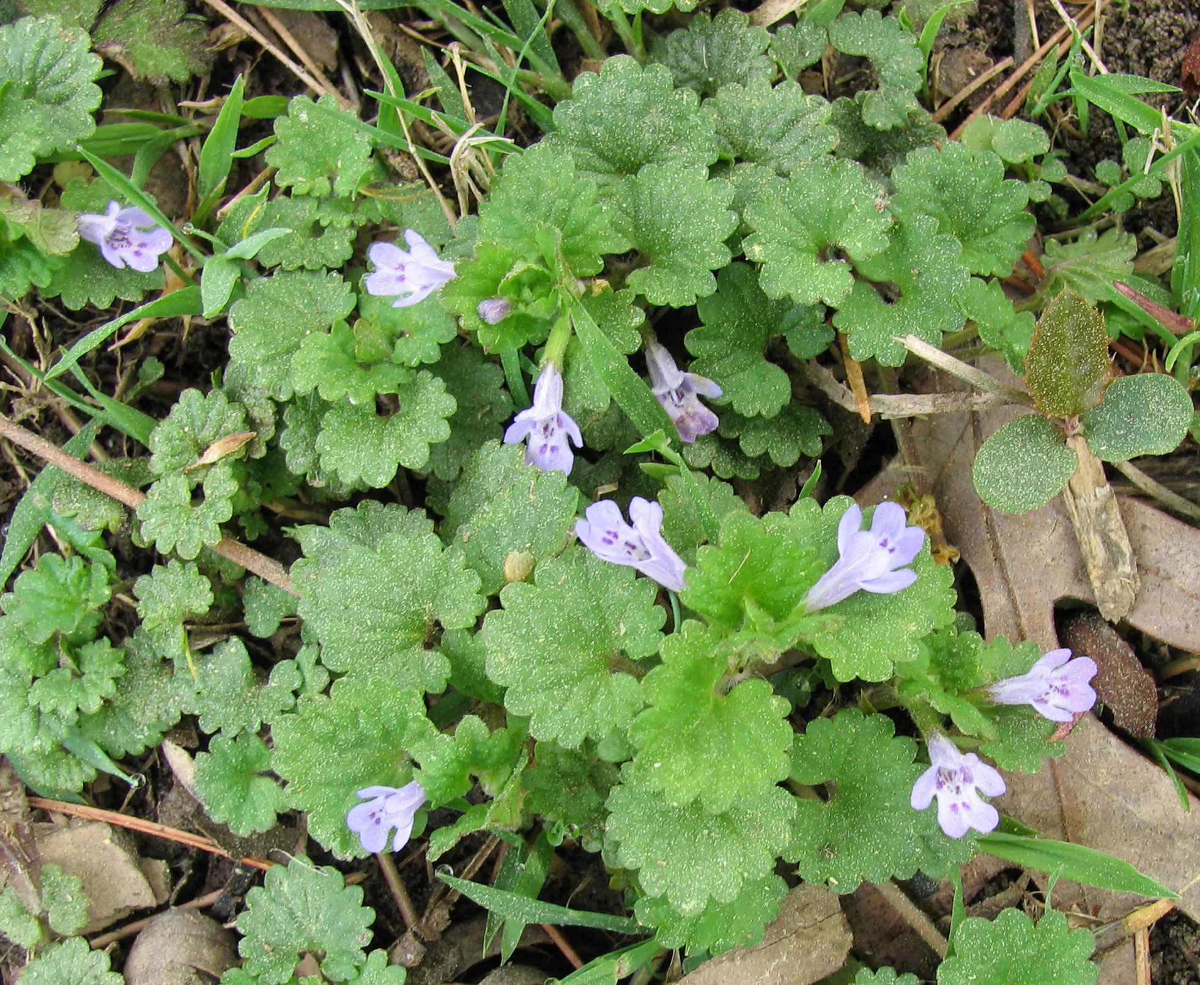
Ground Ivy

Slide 25
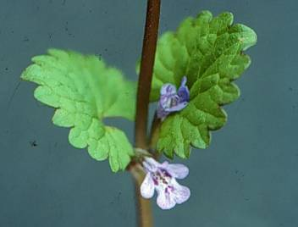
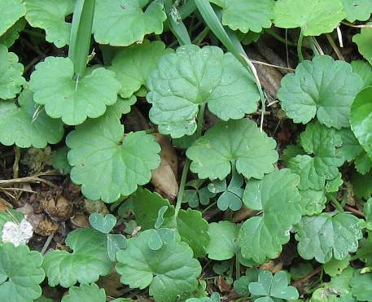
Ground Ivy
Perennial with creeping stems that root at the nodes
Thrives in sun or shade
Opposite leaves round, scalloped along the margin and heavily veined on upper surface
Square stems
Funnel-shaped bluish-violet flowers in leaf axils

Slide 26
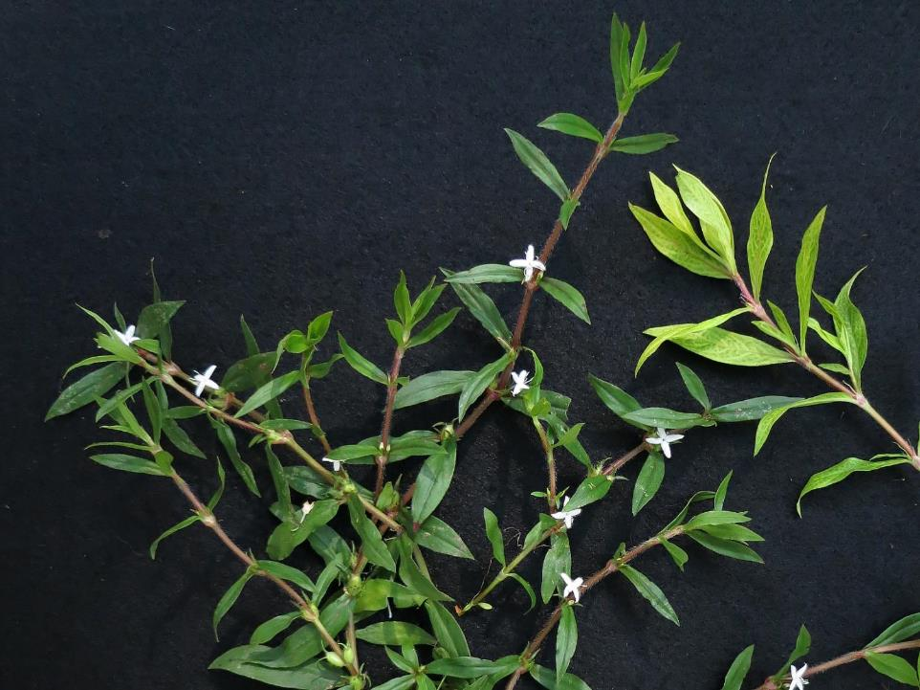
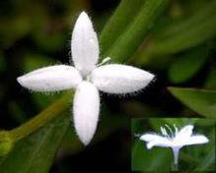
Virginia Buttonweed

Slide 27
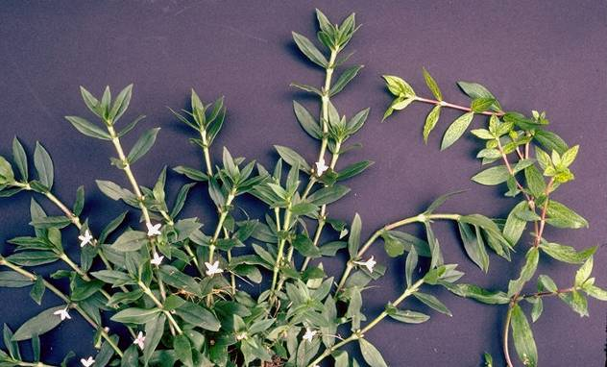
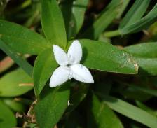
Virginia buttonweed is one of the three toughest weeds to control in Arkansas turfgrass.
Virginia Buttonweed
Perennial with prostrate, spreading branches
Stems hairy along the ridges
Opposite leaves without petioles
Leaves often display mottled yellow mosaic appearance
White flowers sometimes with pink streaks in the center borne in leaf axils
Fruit with 4 membranous sepals at the tip

Slide 28
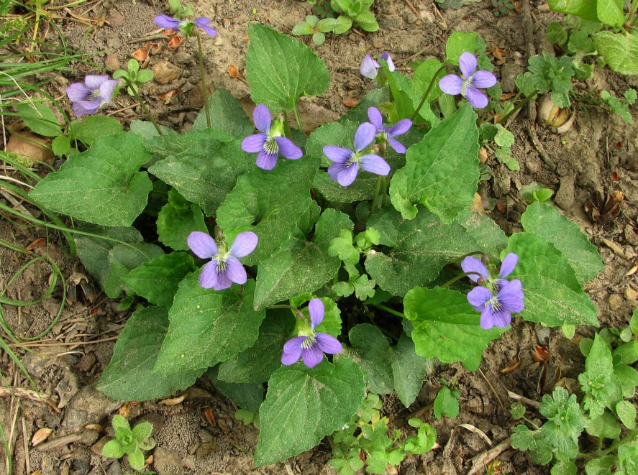
Common Violet

Slide 29
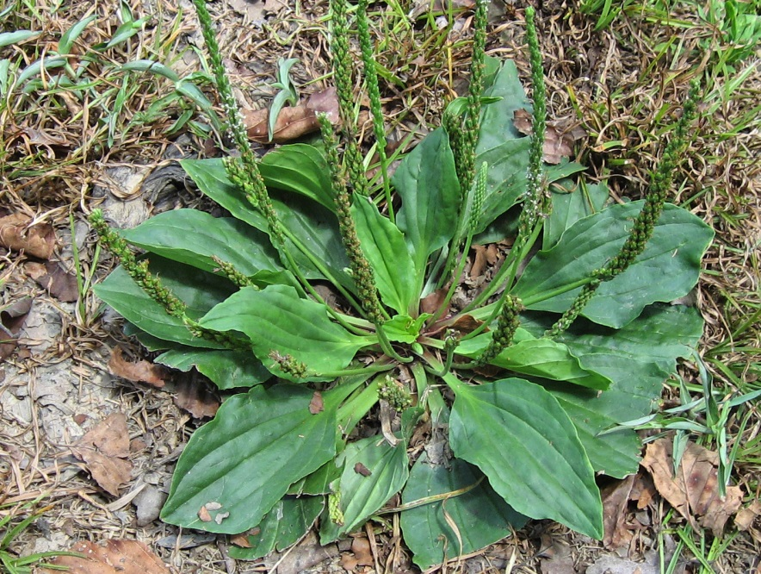
Broadleaf Plantain

Slide 30
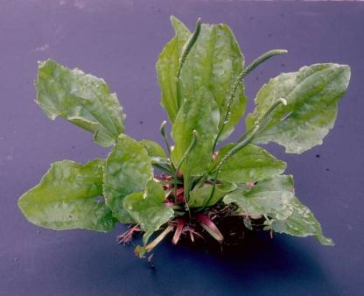
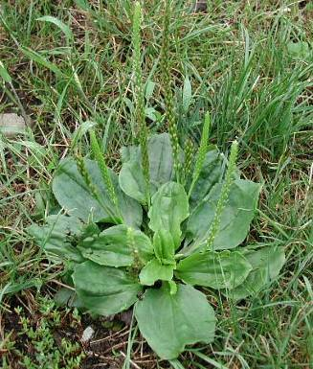
Broadleaf Plantain
Fibrous-rooted perennial
Lower leaves smooth, oval to elliptical shape and purplish at base of leaf stalk
Leaf margins waxy with 5 distinct veins

Slide 31
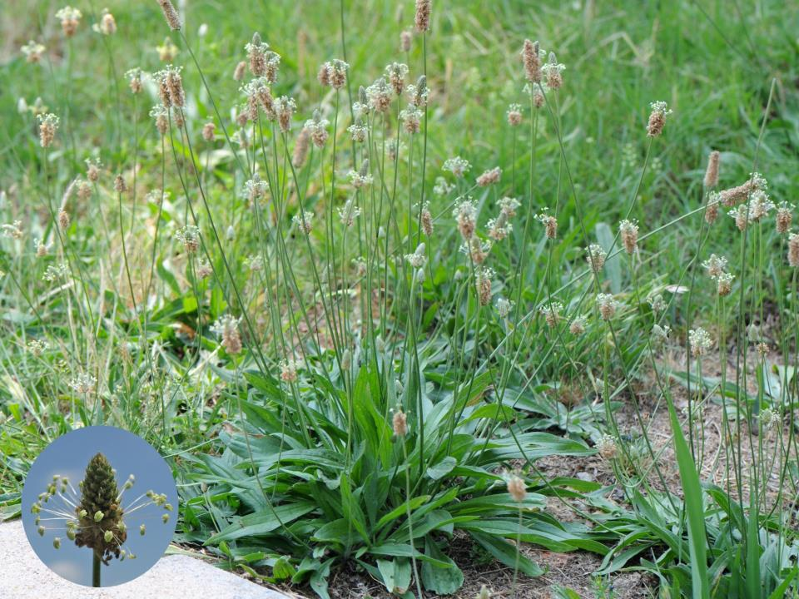
Buckhorn Plantain

Slide 32
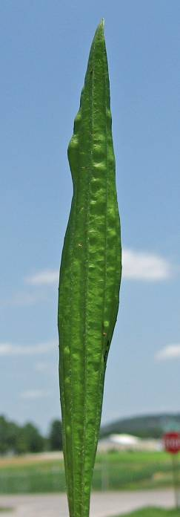
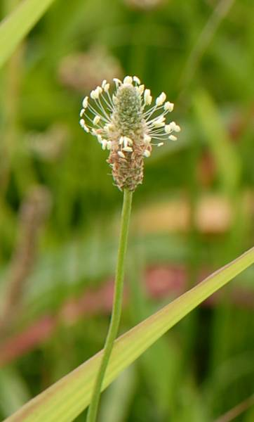
Buckhorn Plantain

Slide 33
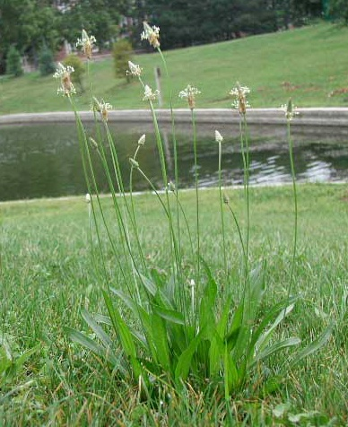
Buckhorn Plantain
Fibrous-rooted perennial
Leaves basal, long and pointed with several prominent parallel veins
Flowers arranged in a dense terminal spike

Slide 34
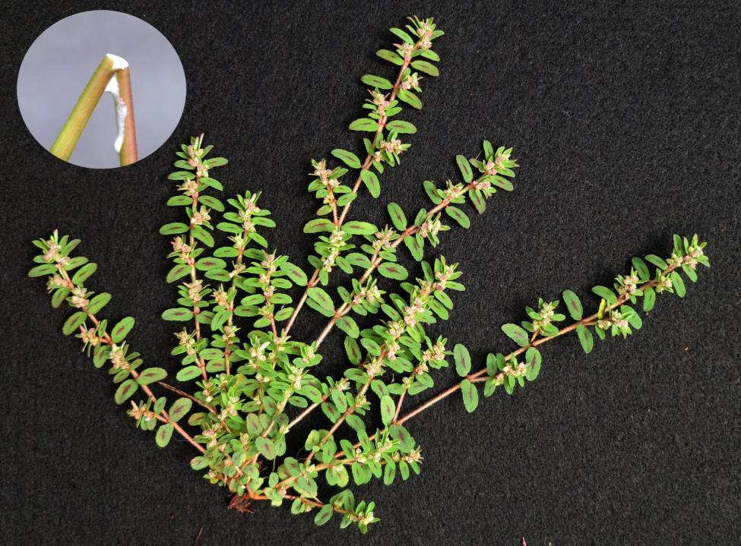
Prostrate Spurge

Slide 35
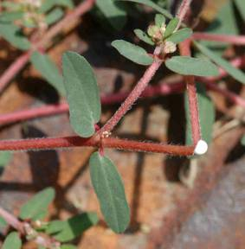
Prostrate Spurge
Low growing summer annual
Reddish-green stems from a tap root that produce a mat-like growth habit and emit a milky juice when broken
Can choke out thin turf
Leaves opposite usually with conspicuous maroon blotch
Pinkish-white inconspicuous flowers borne at the leaf axils

Slide 36
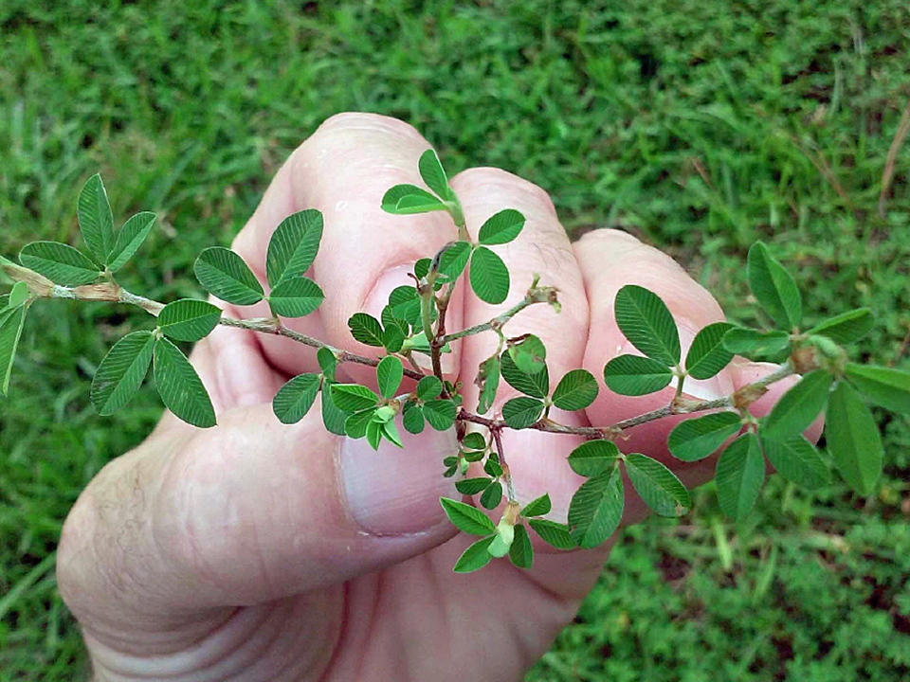
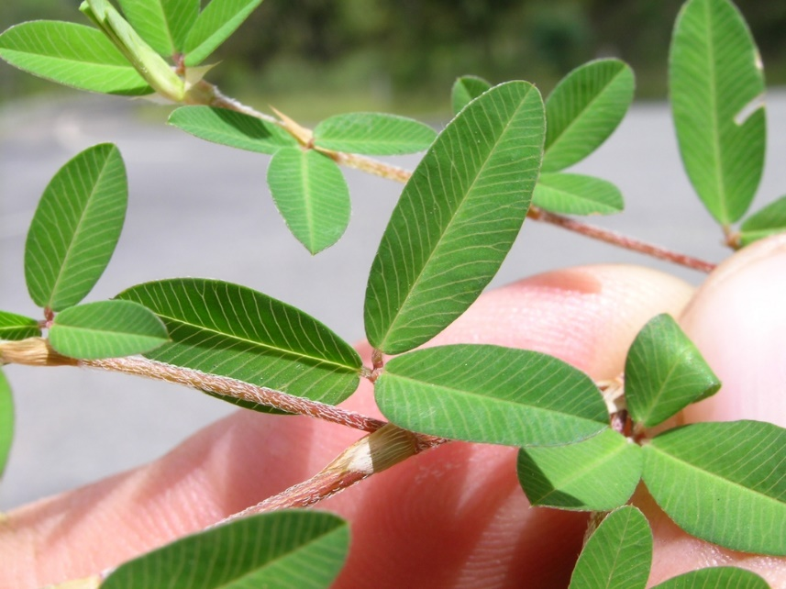
Common Lespedeza

Slide 37
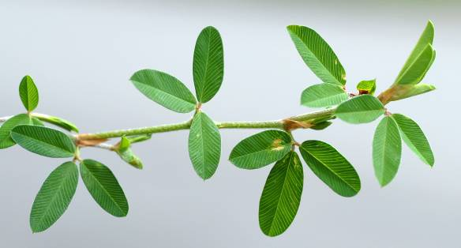
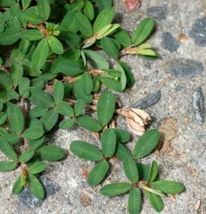
Lespedeza
Low growing summer annual
Tough, wiry, hairy stems from a tap root that produce a mat-like growth habit
Can choke out thin turf
Trifoliate leaves dark green
Pink to purple flowers borne at the leaf axils

Slide 38

Lespedeza

Slide 39

Common Chickweed

Slide 40

Common chickweed

Slide 41

Common chickweed

Slide 42



Common Chickweed
Low spreading winter annual, weak root system
Roots at the nodes
Opposite leaves with no hairs tapered to a point
Stems with vertical lines of hairs
Small white flowers with 5 deeply notched petals
seed

Slide 43

Henbit

Slide 44

Henbit
Very common winter annual
Square 4-sided greenish-purple stems
Flowers with purple petals fused into a two-lipped tube
Stems upright but can root at the nodes
Leaves rounded, coarsely toothed, hairy and deeply veined

Slide 45


Henbit

Slide 46

Henbit Seedling

Slide 47

Hairy Bittercress

Slide 48

Hairy Bittercress
Winter annual with erect stems
Over winters as a basal rosette
Leaves deeply lobed
Small flowers with 4 white petals
Fruit capsule about 0.75” that pops open when mature

Slide 49



Hairy Bittercress

Slide 50
Weeds
Sedges / Tubers / Other

Slide 51


Sedges have triangular stems with a solid, pithy interior.
“Sedges have edges…”
Sedges have leaves in groups of three

Slide 52


Purple nutsedge
Yellow Nutsedge

Slide 53

Yellow nutsedge with seedheads

Slide 54


Yellow Nutsedge
Cold-tolerant perennial sedge species. Emerges about 3 weeks before purple nutsedge.
Control in spring using postemergence herbicides before tubers form.
Tubers form 6 to 8 weeks after leaves emerge.
rhizomes
Yellow nutsedge rhizomes
Yellow nutsedge tubers

Slide 55

Purple Nutsedge

Slide 56

Purple nutsedge with rhizome

Slide 57

purple nutsedge
yellow nutsedge
Leaf tip shape helps separate purple and yellow nutsedge.

Slide 58

Purple Nutsedge - A tuber forming perennial sedge found in tropical and temperate regions. Mostly in warm-season turf.
Purple nutsedge leaf tips are blunt

Slide 59




purple nutsedge
purple nutsedge seed head
purple nutsedge rhizome
purple nutsedge tubers have a bitter flavor

Slide 60
Purple Nutsedge
Reddish-purple seed head
Tubers bitter
Tubers in chains
Leaf tip blunt

