Slide 1
National Chapter Award
POA to NCA and Everything in Between!

Slide 2

What is your comfort level…
Program of Activities (POA)?
National Chapter Award (NCA)?

Slide 3

What is your greatest…
Challenge?
Uncertainty?
Notes:
Challenges implementing, getting started, with ideas? Confused on the rules, processes?

Slide 4

Big Picture: Why the National Chapter Award Matters
Chapters that plan and implement meaningful activities that develop members, serve their community, and promote agriculture.
Students identify needs, plan activities, lead implementation, and reflect on results, building leadership and real-world skills.
Activities submitted for the award come directly from the chapter’s Program of Activities, highlighting activities from each area: Growing Leaders, Building Communities, and Strengthening Agriculture.
Notes:
What does it recognize?
How does it support student leadership?
How does it connect to the POA?
The National Chapter Award recognizes chapters that take action through meaningful, student-led activities that develop members, serve their communities, and promote agriculture.
Through these activities, students plan, lead, and reflect, building leadership skills while creating real impact in their school and community.
The activities highlighted in the award come directly from the chapter’s Program of Activities (POA), showcasing how the chapter’s plans turn into intentional experiences and measurable impact.
💡 Key Message: Most chapters are already doing this work through their POA. The National Chapter Award simply helps them document their efforts, reflect on their impact, and share their story.
Activities should be intentional and meaningful, not just checking boxes
QS help show well rounded chapter programming

Slide 5


National Chapter Award Roadmap
National Middle School Model of Excellence
National Premier Chapter Awards
National Model of Excellence
State Gold, Silver, and Bronze Chapter Awards
National FFA Star Chapter Awards
State Superior Chapter Award
Program of Activities (POA)
(Can only be considered if a 3-star chapter)
Notes:
The National Chapter Award Program is designed to recognize FFA chapters that actively implement the mission and strategies of the organization. These chapters improve chapter operations using the National Quality Chapter Standards (NQCS) and a Program of Activities (POA) that emphasize growing leaders, building communities and strengthening agriculture. Chapters are rewarded for providing educational experiences for the entire membership.
In order to qualify for a state or national award (form 2), your chapter must complete at least 15 activities: one for each of the five quality standards in each of the three divisions. Additionally, the chapter must meet the minimum requirements as outlined in the National Quality Chapter Standards.
Every chapter that meets the minimum quality chapter standards and completes Form I will qualify as a state superior chapter. Chapters receive a superior chapter certificate each year they achieve this level. The chapter will also be eligible to compete for their state’s Gold, Silver and Bronze chapter awards.
To compete for state gold, silver or bronze awards, chapters must qualify for the superior chapter award and complete Form II. Chapters use Form II to report goals, plans of action and results/evaluation on three activities for each division. Chapters receive a multi-year plaque and yearly plaque inserts, commonly known as spurs, specifying the level achieved each year.
The state’s top three gold chapter award winners (or the number equal to 10 percent of the state’s total number of chapters, if that number is higher) are eligible to compete for the National FFA Star Chapter Awards.
Chapters that receive a gold rating by their state FFA associations are eligible to compete for National FFA 3-star, 2-star or 1-star ratings. Each chapter that competes for these awards will receive a multi-year plaque and a spur designating their 3-star, 2-star or 1-star rating. Chapters that receive a national 3-star chapter rating will be eligible to compete for the National Premier Chapter Awards, Models of Excellence and Middle School Models of Excellence Awards.
The national level also recognizes the top chapters with innovative activities in each of the three divisions: growing leaders, building communities and strengthening agriculture. The top ten chapters in each division receive a National FFA Premier Chapter Award plaque. Of those top ten in each division, a top premier chapter will be chosen in each division. Only 3-star chapters are eligible for premier chapter awards.
Ten high school chapters will be chosen as Model of Excellence chapters. Five middle school chapters will be selected as Middle School Model of Excellence chapters
Finalist judging and then in-person presentations at Convention

Slide 6
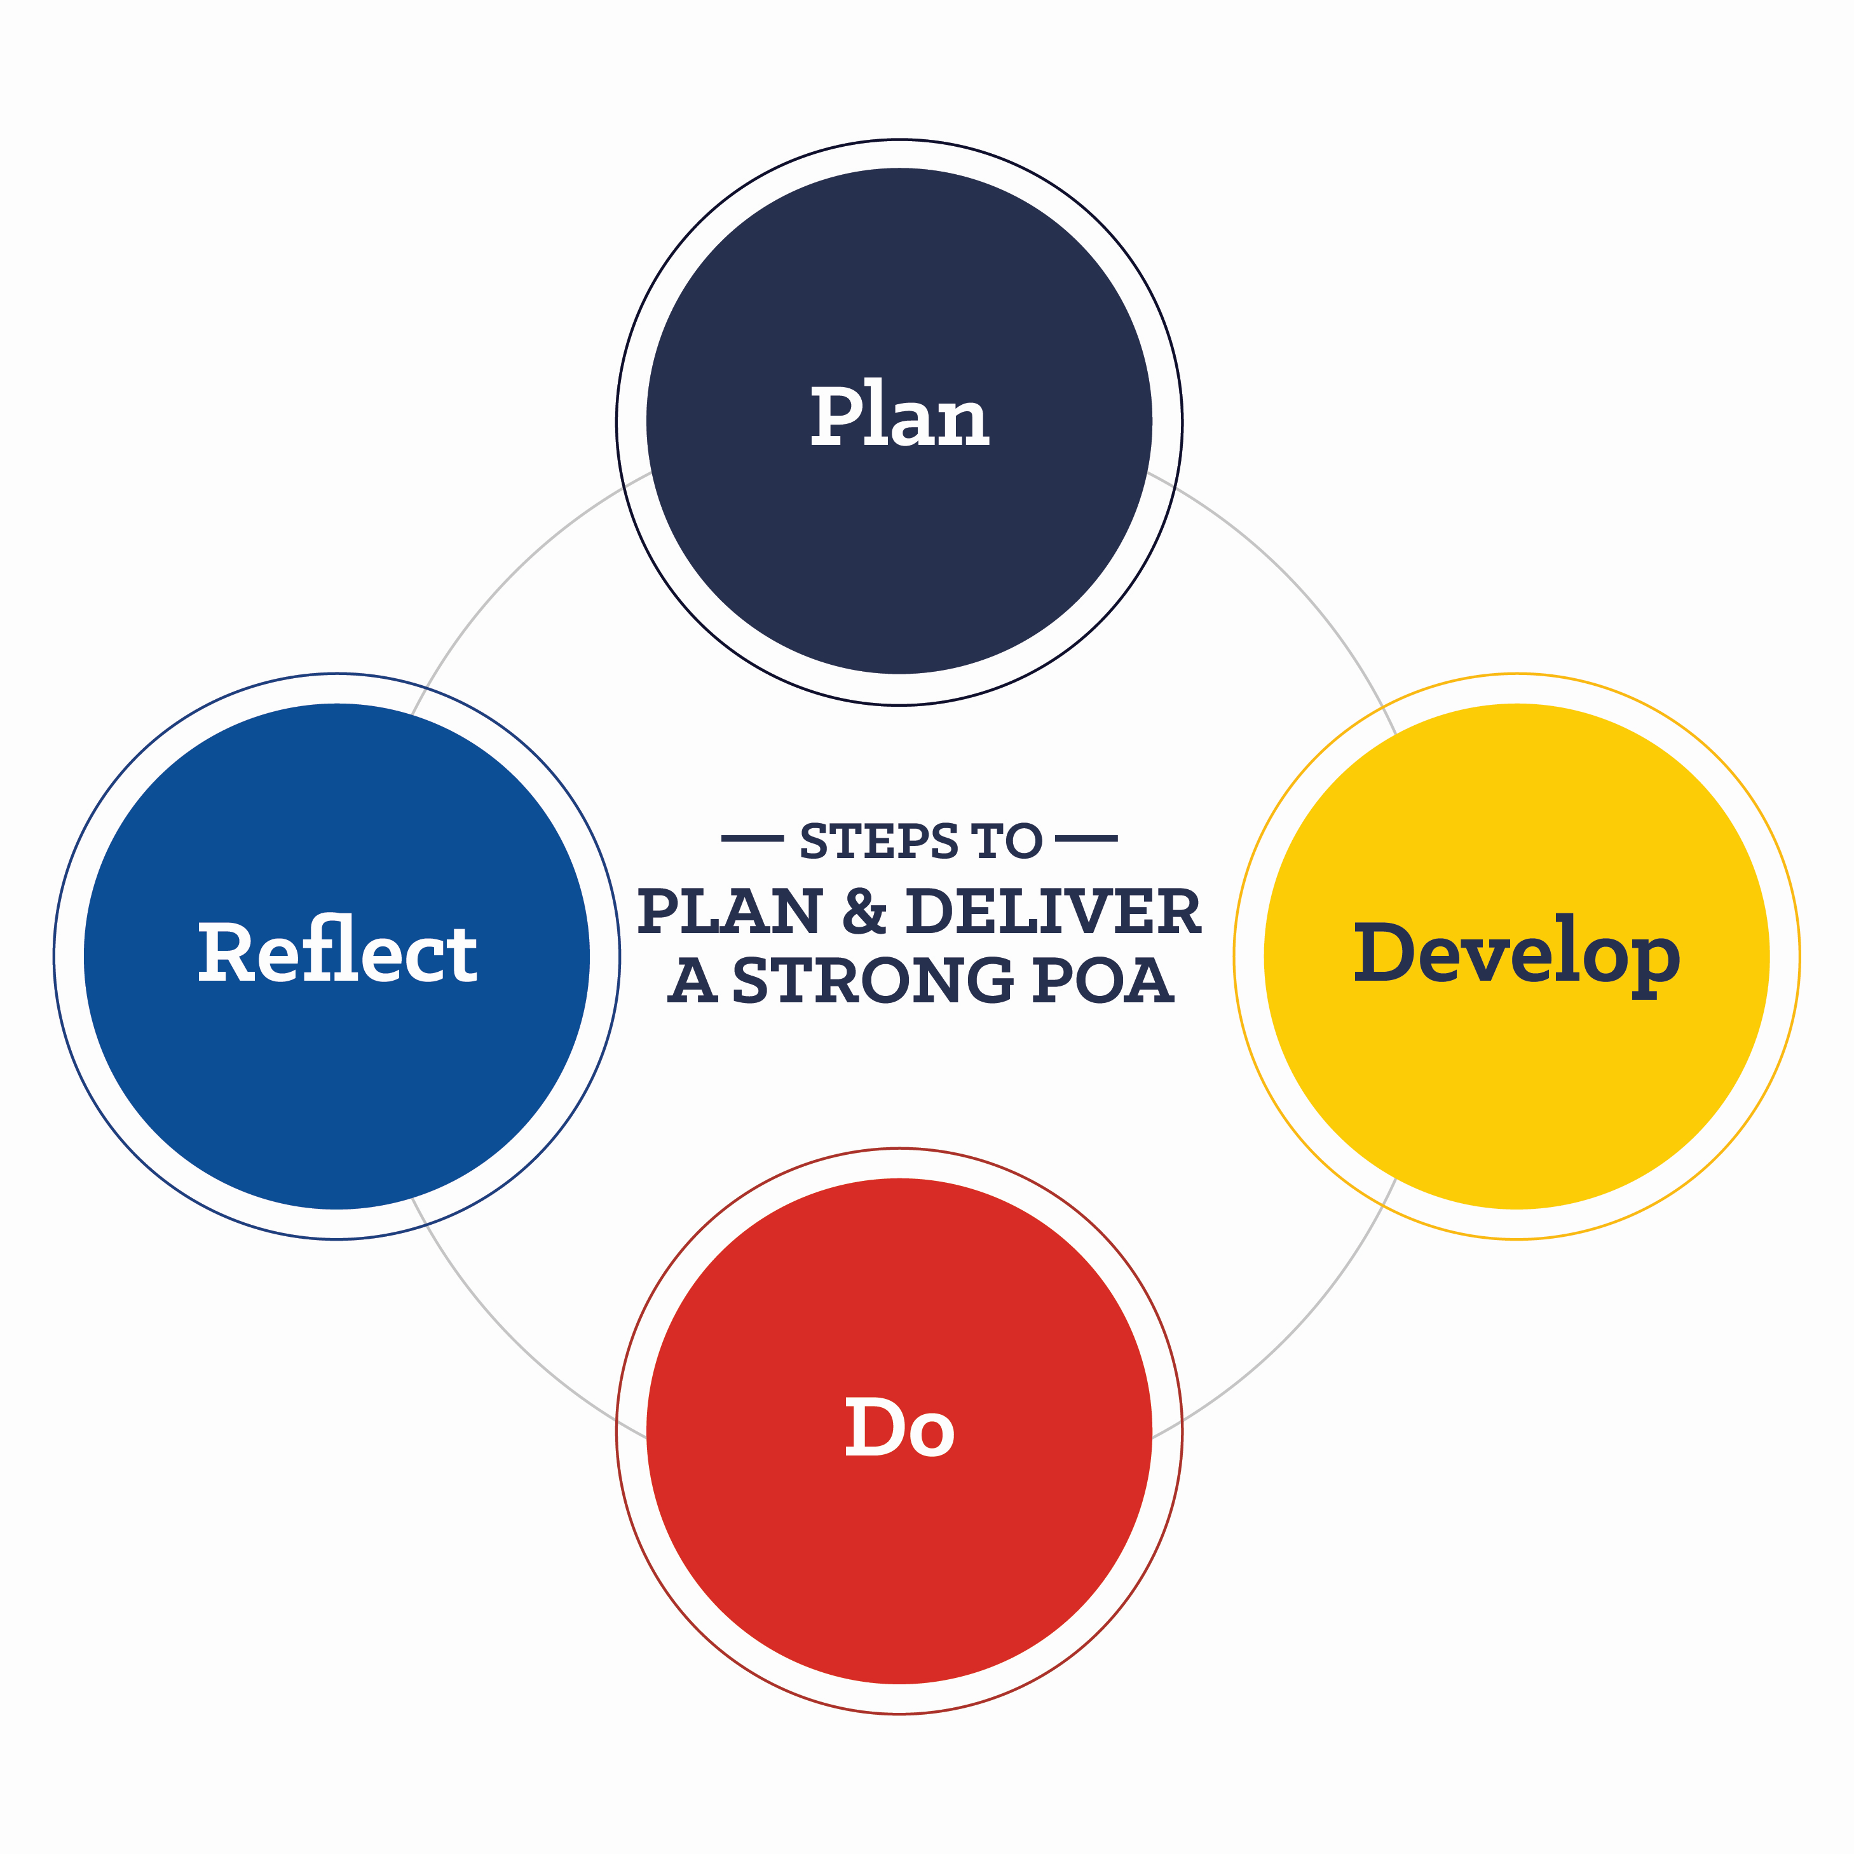

What is a Program of Activities (POA)?
Defines Goals & Plans
Guides Chapter Activities
Engages Stakeholders
Supports Leadership & Growth
Ensures Organization & Success
Develops Student Skills
Encourages Member Involvement
POA Resource Guide
Notes:
FOUNDATION
The Program of Activities (POA) serves to define chapter goals, outline steps needed to meet those goals and act as a written guide to provide a calendar of events the chapter will follow in the year ahead.
The Program of Activities (POA) serves to define chapter goals, outline steps needed to meet those goals and act as a written guide to provide a calendar of events the chapter will follow in the year ahead for administrators, advisory committees, alumni and other stakeholders. Every year each FFA chapter takes time to plan ways to provide engaging opportunities focused on growing leaders, building communities and strengthening agriculture. A well-planned POA will ensure chapter activities meet the needs of its members, provide direction from year to year, lead toa workable budget, provide experience in planning and serve as a reference point throughout the year. Success is the result of creative planning and detailed preparation. In order to invest in chapter success, students set goal sand plan the necessary steps to accomplish these goals. The POA provides a structure for student committees. By engaging in the development and delivery of a quality POA, students develop leadership and planning skills which are essential in all careers. The key to a quality POA is getting every member involved.
POA Timeline Guide
Talk about each step
Plan- use a timeline and think of committees
Develop- Utilize Form 1 and have committees/ officers pick activities
Do- SMART GOALS, do the activities on your POA,
Reflect- Use Form 3 and 4 to reflect, what went well and not. Ideas for next time using recognition guides!
Remember! Not all activities have to be a success! Or even on a large scale.

Slide 7
State Superior Award
Submit one activity related to each quality standard (15)- include title and description
Meet the minimum criteria outlined in the National Quality FFA Chapter Standards (NQCS)
Notes:
Minimum score- 51/64 points.

Slide 8
State Gold, Silver, Bronze Awards
Qualify for the State Superior Chapter award
Fill out Form II- report goals, plans of action and results/evaluation on three activities for each division. (selected from Form I)
State judges rank the chapters as gold, silver or bronze based on the rubric. Send a set number of applications to National FFA for judging.

Slide 9
National FFA Chapter Award
The total number of chapters in the state determines the number of applications sent to Nationals. (10% of chapters)
At the national level, judges rate the chapters as 3-star, 2-star, or 1-star.
Only a 3-star chapter is eligible for additional awards.

Slide 10
Additional Awards
Model of Excellence
Chapters exemplify great qualities in all categories of growing leaders, building communities, and strengthening agriculture. (Top overall application scores)
Premier Awards
Innovative activities are selected in each division: growing leaders, building communities, and strengthening agriculture. (Flagged by judges for unique activities)

Slide 11
Summary: Form I vs. Form II
Form I
AKA- State Superior Chapter Award
15 Quality Standard Activities (Activity Title & Description Only)
NQCS Self Assessment
Form II
State Gold, Silver, Bronze Awards & National FFA NCA Application
From Form I, select 9 of the 15 QS (3 from each Division) to expand on with goals, a plan of action, and impact for each activity

Slide 12
Using the POA to Plan Activities
NCA should align with what the chapter is already doing!
The POA should drive NCA activities
Advisors should not create separate events just for NCA
Activities can come from:
Existing chapter events
Community engagement
State activities

Slide 13
POA: Divisions and Quality Standards
3 Divisions
5 Quality Standards in each Division
Notes:
How the POA is Organized

Slide 14
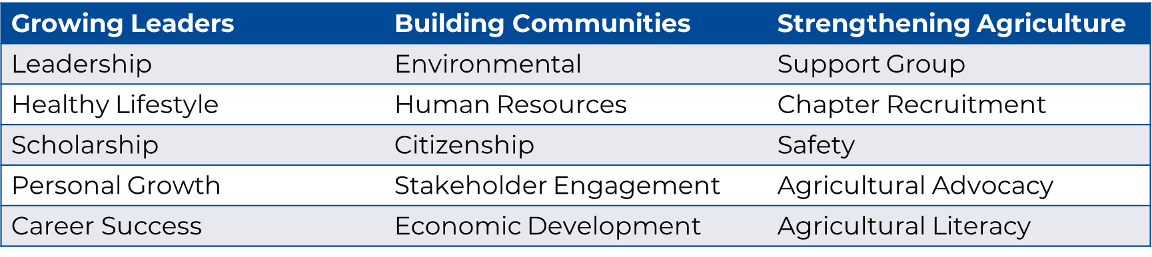
National Chapter Award Quality Standards
National Chapter Award Divisions and Quality Standards

Slide 15

Which is Which? Same Vibe, Different Standard
Stakeholder Engagement
Leadership
Agricultural Advocacy
Notes:
Support Group: Activities conducted to developand maintain positive relations among FFA,parents and community leaders interested insupporting agricultural education.
Stakeholder Engagement: Activities conducted todevelop teamwork and cooperation between thelocal chapter and stakeholders. (NO ALUMNI & SUPPORTERS)
Personal Growth: Activities conducted that improvethe identity and self-awareness of members. Theseactivities should reflect members’ unique talentsand potential by reinforcing their human andemployability skills. The activities should strive toenhance the quality of life and contribute tomembers’ life goals and development.
Leadership: Activities that help the individualdevelop technical, human relations and decision-making skills to grow leaders.
Agricultural Advocacy: refers to activelysupporting, promoting, and defending agricultureto various audiences. Agricultural advocates workto influence public opinion, shape policy, and gainsupport for agricultural practices and policies.
Agricultural Literacy: refers to the understandingof basic concepts related to agriculture, includingits processes, history, and importance to societyand the economy.
Agricultural advocacy often builds upon agricultural literacy!!!

Slide 16

Put it into Perspective
State Legislative Leadership Conference (SLLC)
Let’s break down a real example of an NCA activity on AET. This would be one of the nine activities included in the application.

Slide 17
FORM I

Slide 18
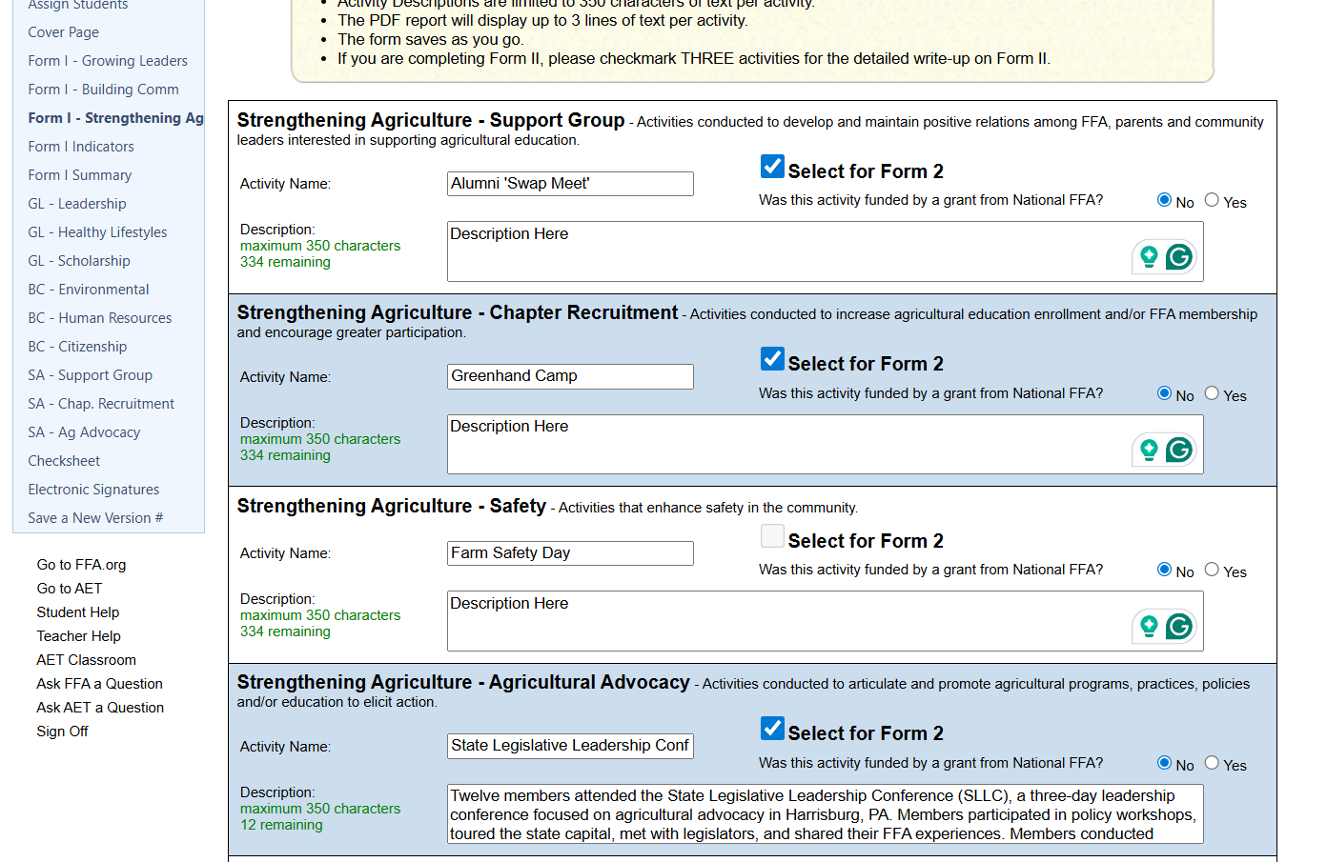
Notes:
Just listing all 15 QS with activity title and description

Slide 19
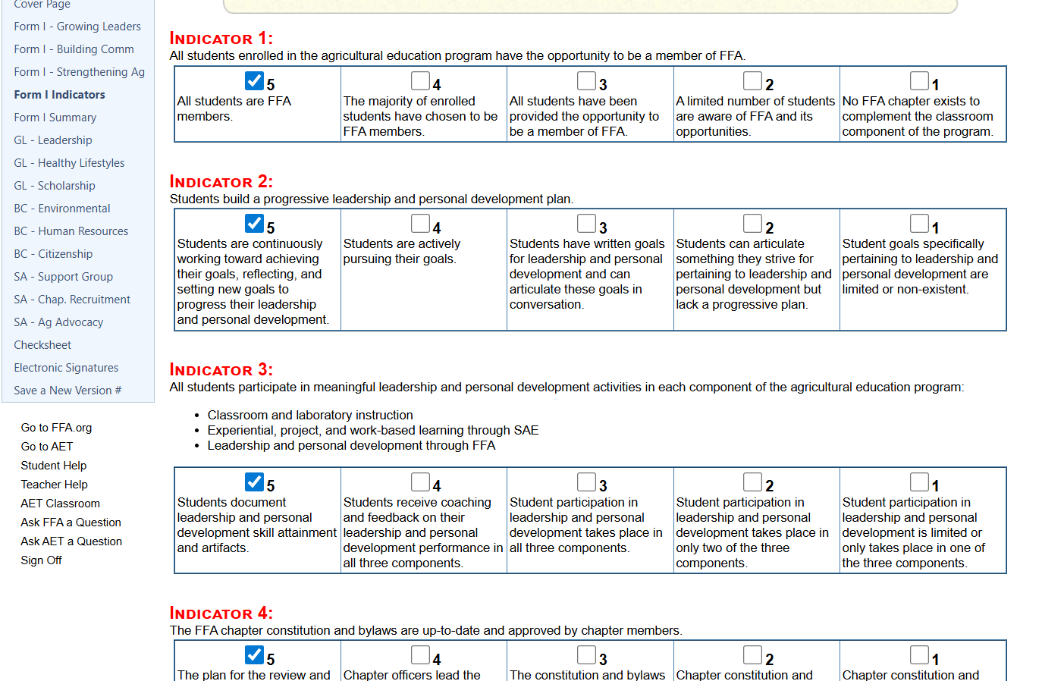
Notes:
13 Indicators (self evaluation assessment)

Slide 20
FORM II

Slide 21
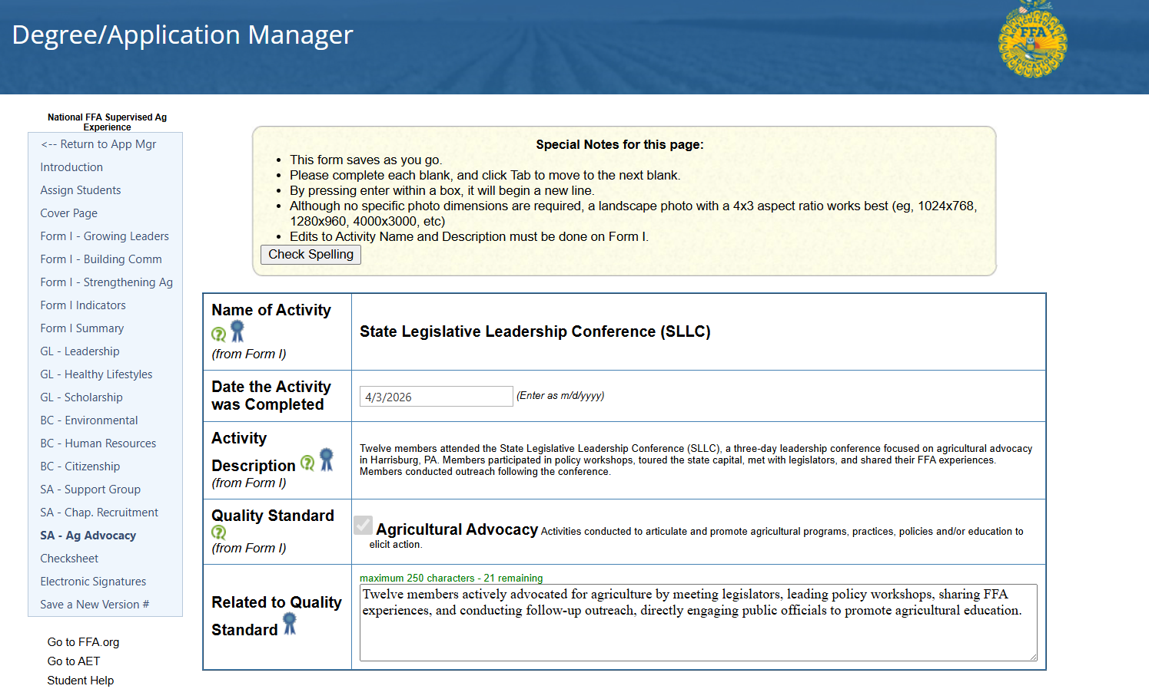

Form I
Form II
Notes:
When you select 9, they pop up below, and then you can add the additional information. The title and description will already be auto populated for you.

Slide 22
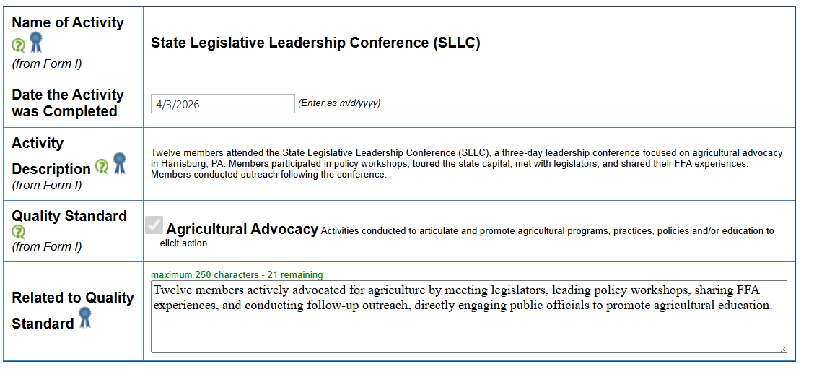

Slide 23
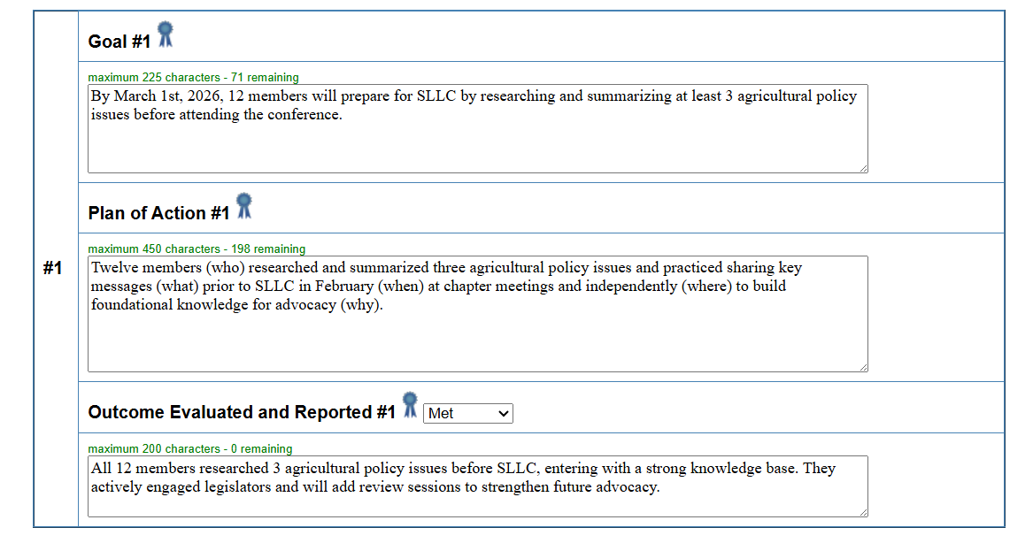

Slide 24
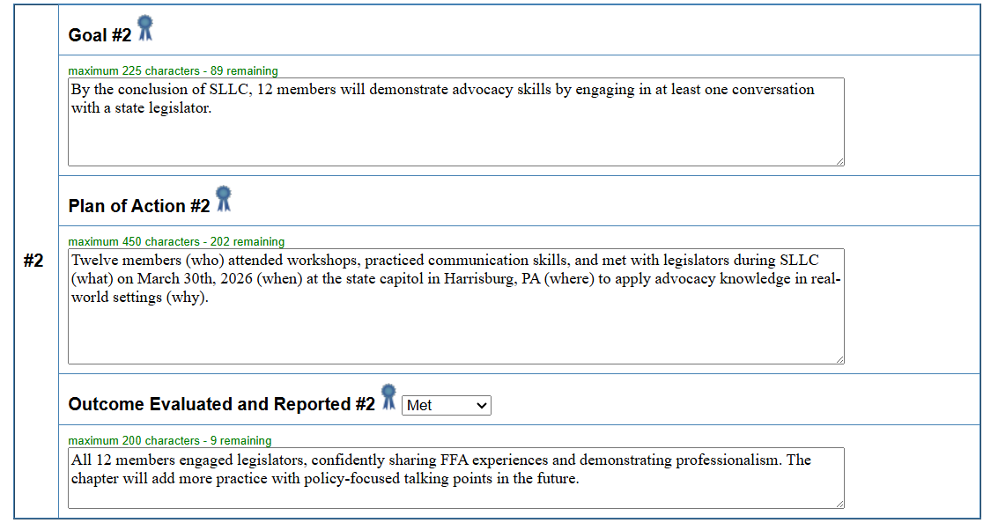

Slide 25
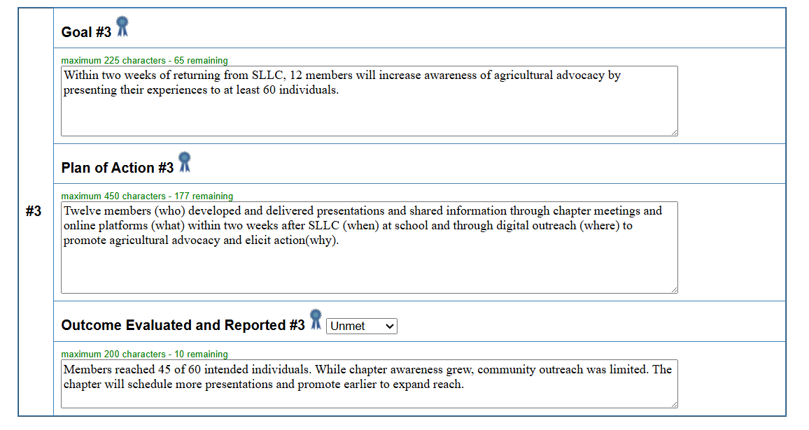

Slide 26
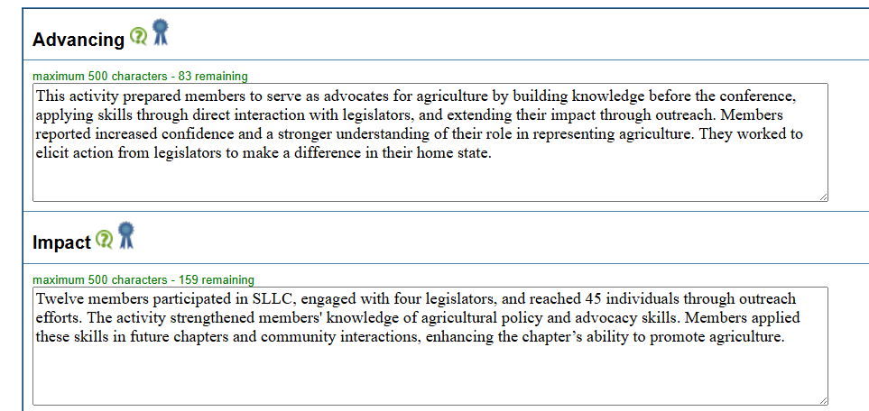
* You will also have a photo and a photo caption for each activity

Slide 27
Few Words, Big Impact!
Write clear and concise responses
Use AI tools to help shorten or refine language
Lead with the impact and outcomes
Avoid unnecessary background information
Notes:
Activities• Include a brief description of an activity within each quality standard.• A maximum of 350 characters per quality standard is permitted with the exception of:• Plan of Action – 450 maximum• Outcomes – 200 maximum• Advancing Leaders – 500 maximum• Impact – 500 maximum Indicators
Application boxes have small word limits.
Be concise
Use AI tools to help condense language

Slide 28

Lightbulb Moments
Activities should be student-led and student-centered, not advisor-driven
Use the Program of Activities (POA) as the structure for planning and organizing ideas
Review the NCA Recognition Guides for inspiration and examples of possible activities
AI tools can also support brainstorming and help generate project ideas
Use the Envelope Game brainstorming activity
Notes:
Envelope Game: Work in small groups. Each group receives a different QS envelope with a random item inside.
Using the item inside, design a new chapter activity that aligns with the QS listed on the envelope. Identify: Community Needs, Member Interests, Available Manpower
Students are the ones who:
Identify needs
Brainstorm solutions
Plan activities
Lead implementation
Evaluate results
FFA advisors guide the process, but students lead the work.

Slide 29

Resources
POA
NCA
POA Divisions and Quality Standards
NCA Handbook
NCA Rubrics
POA Forms 1-4
NCA Recognition Guides
POA Resource Guide
Notes:
Show on computer

Slide 30

Fake News
Only large chapters with large activities can be successful
You cannot submit the same activity each year
Advisors have to complete and submit the entire application by themselves
The NCA application is difficult and adds too much extra work
Our chapter doesn’t do “special” activities, so we would not win
It takes too much time to complete the application
The writing in the application has to be perfect
We have never applied before, so we probably would not place
Notes:
Advisors often think NCA is extra work
In reality, it is about capturing what the chapter already does
A strong closing message could be:
If your chapter has a Program of Activities and students are leading events, you are already building a strong NCA application. The key is documenting that impact.

Slide 31

Reality Check
Chapters of ALL sizes can apply and be successful
Strong activities can be repeated each year when they continue to create impact
Students should take an active role in completing the application with advisor guidance
The application reflects work chapters are already doing through their POA
Meaningful, well-planned activities matter more than “special” or large events
Documenting activities during the year makes the application manageable
Clear explanations of the activity and its impact are more important than perfect writing
New chapters apply every year and can be competitive when they show strong student leadership and impact
Notes:
Advisors often think NCA is extra work
In reality, it is about capturing what the chapter already does
A strong closing message could be:
If your chapter has a Program of Activities and students are leading events, you are already building a strong NCA application. The key is documenting that impact.

Slide 32

Tips & Tricks to Remember
POA and NCA should be student-centered
Start with a well-developed POA
Utilize resources available, including the rubrics
Don’t force an activity
Make SMART Goals
Brag on Yourself!
Notes:
Should not be more work for the teacher!
Work with the community, school, etc. and look at the needs.
Pictures tell 1000 words! Try and find an activity in all 15 QS to qualify for NCA award.

Slide 33
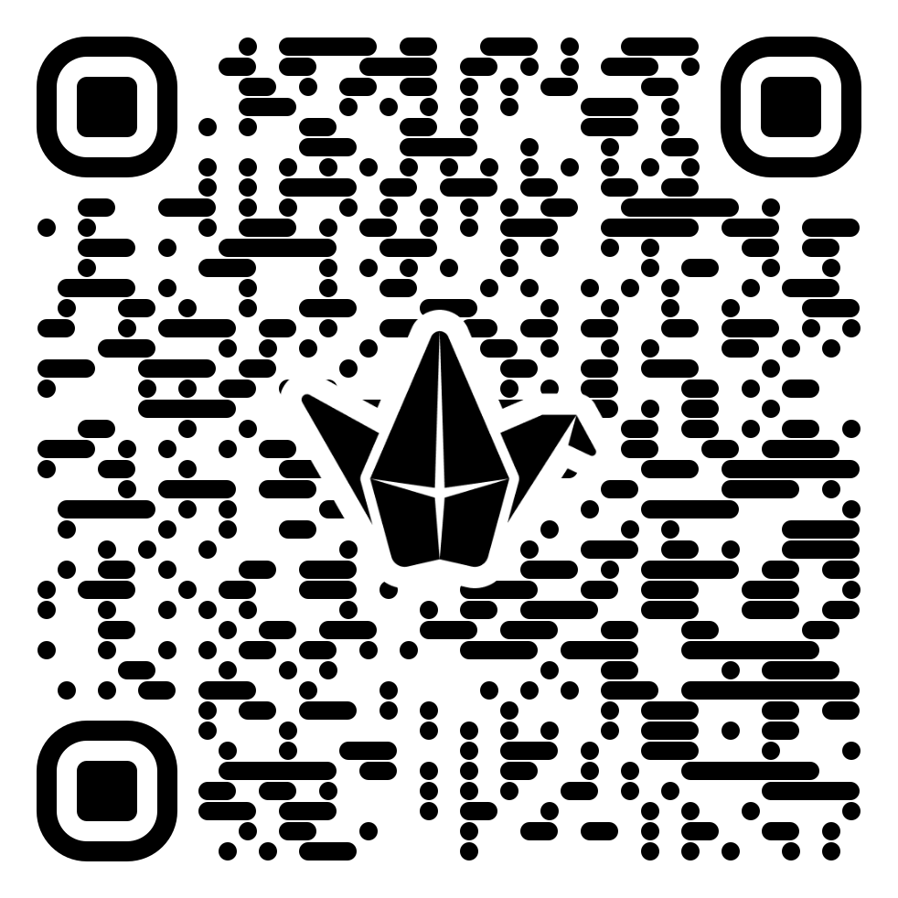

Questions?
Padlet Discussion Board
Notes:
Pros to utilizing a POA can not only plan, but also promote and defend chapter (funding)

Slide 34
Contact
National Chapter Award Program Specialist
Marah Walls
nationalchapter@ffa.org
317-802-4249

Slide 35

NCA Rubric (Form II): Piece by Piece

Slide 36
Related to Quality Standard
The activity and benefits relate directly to the chosen quality standard.
Use the quality standard definitions and example activities to determine if the activity is appropriately categorized.
National Chapter Award Divisions and Quality Standards
Notes:
CHARACTER COUNT- 250
If the activity is not related, score accordingly using the revised rubric now that deductions are built in.
Each division in the POA has five quality standards that typically function as student committees within the chapter. Quality standards and dedicated student committees guide the planning, preparation and delivery of activities in each quality standard area. All chapter activities should provide:
• A balance of experiences inside and outside the classroom
• Opportunities for developing self-confidence, responsibility, citizenship, cooperation and leadership skills
• Authentic, engaging activities
• Relevant, educational experiences
• Accessibility for all students
• Flexibility that will allow chapters from various environments and with various levels of resources to be successful
• Multiple levels of participation and experiences
• Appropriate recognition for all participants
• Exposure to opportunities and educational experiences for food, agriculture and natural resources

Slide 37


Fundraisers
Benefits Chapter
Benefits Community
Benefits Students
Memorial Scholarship
Notes:
True Fundraisers are not a quality standard
Though fundraisers are not a quality standard, if they fit in the QS, they can be used. EX. Scholarships, Community activities, Examples
Activities such as benefits or charity events that benefit community members or the community should be used under the Citizenship Quality Standard.
If it benefits the chapter, it does not count
are not part of the National Chapter Application, as there is no quality standard that aligns with this type of activity.
Fruit, meat, plant and cookie sales can occur and be considered as long as the chapter is not profiting from the money.

Slide 38
Understanding an Activity Description
What is the purpose of this activity?
Why is this activity taking place?
Notes:
The description clearly explains the purpose and reason the chapter is implementing the activity.
CHARACTER COUNT- 350

Slide 39

Activity Description Examples
High Points: (5-4)
The chapter organized a community garden project to promote sustainable agriculture and provide fresh produce to local food banks. This initiative was designed to educate students and community members on environmentally friendly farming practices while addressing food insecurity in the area.
Purpose
Why
Notes:
The description clearly explains the purpose of the activity and why the chapter is implementing it. Answers key questions: What is the purpose? Why is the activity taking place?

Slide 40
Activity Description Examples Cont.
Mid Points: (3-2)
Our chapter hosted a garden project to help the community and teach people about farming. The activity involved students and local volunteers working together to plant vegetables.
Missing: Purpose
Low Points: (1-0)
We did a gardening event with students and planted different crops. People came and participated.
Vague:
Purpose
Notes:
Mid-The description is somewhat vague but still provides a general idea of the purpose and reason for the activity.
Low-The description lacks a clear purpose or reasoning. May include multiple activities, making it unclear what is being assessed.

Slide 41


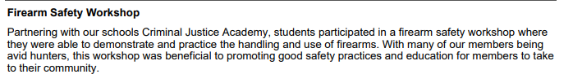
Investigating Activity Descriptions
Redacted
*Personal identifying information, including chapter names and dates, has been redacted
Notes:
High Point chapter examples from the past

Slide 42
What is an Activity?
An Activity is a single, specific action or task undertaken as part of a larger program or goal.
An Activity is often smaller in scale and focused on a particular objective.

Slide 43
Examples of Multiple Activities
Leadership Development Day (Incorrect Example)
Activity Description:
🔴 Why This Is Wrong:
This includes CDE/LDE preparation, SAE discussions, leadership workshops
The activity lacks focus and spans multiple quality standards.
✅ How to Fix It-
Suggested Description:
Activity Description:
FFA chapter officers organize three leadership workshops throughout the year, focusing on personal growth, teamwork, and communication skills. These interactive sessions help members develop confidence, set goals, and enhance decision-making abilities, fostering strong leaders within the chapter and community.
FFA members participate in leadership workshops, public speaking training, and team-building activities. They also prepare for CDE/LDE contests and discuss SAE projects.
Submitted under Growing Leaders- Leadership.
Leadership
Notes:
If the focus is on personal leadership growth or contest participation, classify it under Growing Leaders – Leadership
If it's about mentoring younger members, it could fit under Chapter Recruitment in Strengthening Agriculture (but must exclude contest prep).

Slide 44
Examples of Multiple Activities
Community Ag Awareness Fair (Incorrect Example)
Activity Description:
🔴 Why This Is Wrong:
This blends agricultural literacy, advocacy, and chapter recruitment into one activity.
✅ How to Fix It-
Suggested Description:
Activity Description:
FFA members organize an agriculture awareness event with guest speakers, food demonstrations, petting zoos, and hands-on CDE competition stations for the public. The event also promotes FFA membership and SAE opportunities.
Contained: CDE, SAE, Ag Advocacy, Ag Literacy Petting Zoos.
FFA members hosted a Community Ag Awareness Fair in May, featuring hands-on stations about crop production, livestock care, and ag technology. Members engage the community through interactive exhibits, demonstrations, and discussions, increasing public understanding of modern agriculture’s role in daily life.
Submitted under Strengthening Agriculture- Agricultural Literacy.
Ag Literacy
Notes:
If the focus is on teaching the public about agriculture, categorize it under Strengthening Agriculture – Agricultural Literacy and remove recruitment and CDE elements.
If it’s about recruiting members, place it under Strengthening Agriculture – Chapter Recruitment and remove advocacy and literacy components.

Slide 45
Goals, Plan of Action, and Outcomes
What plans were made
What the chapter hopes to gain or experience from doing the activity
Clearly understand the planning process for the activity
Notes:
The Goals, Plan of Action and Outcomes section is the meat of the application.

Slide 46
Goals, Plan of Action, and Outcomes Cont.
Goals should be written in SMART Format
Specific
Measurable
Achievable
Realistic
Timely
Notes:
CHARACTER COUNT- 225

Slide 47
Goals, Plan of Action, and Outcomes Cont.
Example of SMART Goal
High Points (3)
By December 15, our chapter will recruit 50 volunteers for the community garden project to boost engagement. We’ll achieve this by hosting two info sessions, distributing flyers, and posting on social media weekly to raise awareness and involvement.
Notes:
Well-Written SMART Goal
Specific: Clearly defines what is to be accomplished.
Measurable: Includes a way to track progress.
Attainable: Realistic and achievable.
Relevant: Aligns with chapter goals.
Time-Bound: Includes a deadline.

Slide 48
Goals, Plan of Action, and Outcomes Cont.
Example of SMART Goal
Mid Points (2)
Our chapter will get more people involved in our community garden by promoting it and encouraging volunteers to help.
Low Points (1-0)
We want to make our community garden better and get more people to join.
Notes:
Somewhat Vague SMART Goal
Partially meets SMART criteria but lacks clarity in one or more areas.
(Missing measurable outcome, specific deadline, and detailed action steps.)
Poorly Written Goal
Lacks one or more SMART components.
Too vague or broad.
Low-(No specific actions, timeline, or measurable success criteria.)

Slide 49



Investigating SMART Goals
S
M
A
R
T
Redacted
Redacted
*Personal identifying information, including chapter names and dates, has been redacted
Notes:
High Point chapter examples from the past

Slide 50

Goals, Plan of Action, and Outcomes Cont.
Plan of action should tell the reader who, what, when, where, and how a goal will be achieved.
Who
What
When
Where
How
Notes:
Learn how to appropriately evaluate the goals section. Remember to use the cover page information to help you understand if the goal is achievable and/or realistic.
CHARACTER COUNT- 450

Slide 51

Goals, Plan of Action, and Outcomes Cont.
This can be presented in a variety of styles!
What needs to be accomplished to meet the goal?
When/How will the chapter implement the goal to accomplish this activity?
How will the goal be accomplished? This should include the necessary steps for completion.
Who will preform the duties to meet the goal?
Where will the activity take place?
Notes:
WHO< WHAT< WHEN< WHERE<HOW
Presented in a variety of styles

Slide 52
Goals, Plan of Action, and Outcomes Cont.
Plan of Action Examples
High Points: (3)
To successfully implement the community garden project, we will:
Partner with the city council to secure a garden plot.
Assign committee members to design the layout.
Host a volunteer day for planting.
Create a rotating schedule for watering and maintenance.
Distribute harvested produce to the food bank biweekly.
Measure success by tracking community participation and total food donated.
Notes:
Well-Written & Detailed
Clearly identifies all key components:
What needs to be accomplished?
Where will the activity take place?
How will the chapter implement the goal?
Necessary steps for completion
Who will perform the duties?

Slide 53
Goals, Plan of Action, and Outcomes Cont.
Plan of Action Examples
Mid Points: (2)
For the community garden, we will find a location and gather volunteers. Members will help plant crops, and we will take care of them over time. The goal is to donate food to those in need. We will check on the garden regularly.
Notes:
Somewhat Vague
Partially identifies key components but lacks full details.

Slide 54
Goals, Plan of Action, and Outcomes Cont.
Plan of Action Examples
Low Points: (1-0)
We will have a garden project. People will plant and grow things. The chapter will be involved, and we hope it helps the community.
Notes:
Lacks Clarity
Fails to identify most or all key components.

Slide 55
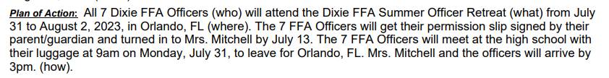
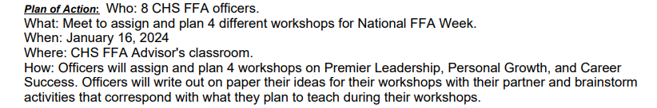
Investigating the Plan of Action
Narrative
Redacted
Redacted
List
*Even without (Who) in the narrative format is acceptable as long the chapter answers the questions!
*Personal identifying information, including chapter names and dates, has been redacted
Notes:
Multiple ways to write- (who) or a list
High Point chapter examples from the past

Slide 56
Outcomes Evaluated and Reported
Met
Unmet
Exceeded
Notes:
Response states whether the goal was unmet, met or exceeded. If all aspects of the SMART goal were met, states by how much if exceeded. If the goal was unmet, the circumstances or reasoning why is explained and what would be done differently next time to meet the goal.
Outcomes should clearly state if the goal was MET, UNMET, or EXCEEDED and by how much it was exceeded. UNMET goals must explain the circumstances or reasoning why the goal was unmet.

Slide 57
Summary of an Activity
The summary of an activity should:
Clearly tell the reader how this activity impacted and benefitted the intended audience.

Slide 58
Advancing (Leaders, Communities, Agriculture)
Advancing (leaders, communities, or agriculture) should clearly state the purpose of the activity and the benefit the activity had on the intended audience.
The chapter provides qualitative data to help explain how their activity advanced leaders, communities, or agriculture.
Notes:
CHARACTER COUNT- 500
QUALITATIVE

Slide 59
Advancing (Leaders, Communities, Agriculture) Cont.
High Points (6-5)
Our chapter hosted a 'Future Ag Leaders' workshop, where 50 members participated in leadership training, public speaking exercises, and team-building activities. Through this initiative, students developed communication skills and confidence. Additionally, five members applied for state FFA leadership roles, demonstrating the program’s impact on their growth. Community leaders also praised the workshop, strengthening our local FFA network.
Notes:
Clearly Defined & Impactful
Clearly states the purpose of the activity and its benefits at or above the local level.
Uses qualitative data to explain how it advanced students as leaders.

Slide 60
Advancing (Leaders, Communities, Agriculture) Cont.
Mid Points (4-3)
Our chapter held a leadership workshop to help students improve their skills. Several members attended and participated in different activities. Some members expressed interest in leadership positions afterward.
Notes:
Somewhat Vague
States the purpose but lacks strong details on leadership impact.
Some data is included but not well connected to leadership growth.

Slide 61
Advancing (Leaders, Communities, Agriculture) Cont.
Low Points (2-0)
We hosted a workshop where members learned about leadership. Everyone had fun and enjoyed the activities. It was a great experience.
Notes:
Lacks Clarity & Impact
Does not clearly state how the activity advanced leadership.
Lacks data or examples of leadership development.

Slide 62



Investigating Advancing (Leaders, Communities, Agriculture)
*Personal identifying information, including chapter names and dates, has been redacted
Notes:
Doesn’t have to say the words Purpose or Benefit as long as it answers those questions
High Point chapter examples from the past

Slide 63
Impact
The impact should clearly explain the impact the activity had on the chapter, its members, and the intended audience.
The chapter provides quantitative data to help explain how the activity impacted the intended audience.
Notes:
CHARACTER COUNT- 500
QUANTITATIVE

Slide 64
Impact Examples
High Points (6-5)
Our chapter’s 'Future Ag Leaders' workshop impacted 50 students, improving their leadership and communication skills. Post-event surveys showed that 85% of participants felt more confident in public speaking, and five members applied for state FFA leadership roles. Additionally, community engagement increased, with local businesses committing to mentor students in future events.
Notes:
Clearly Defined & Impactful
Clearly states the purpose of the activity and its benefits at or above the local level.
Uses qualitative data to explain how it advanced students as leaders.

Slide 65
Impact Examples Cont.
Mid Points (4-3)
The leadership workshop had a positive effect on members. Several students reported learning new skills and feeling more prepared for leadership roles. Some members expressed interest in running for officer positions next year.
Low Points (2-0)
The workshop was a great experience for our chapter. Members learned a lot and had fun. We plan to do a similar event next year.
Notes:
Somewhat Vague Impact
Explains the impact but lacks strong supporting data.
Some data is included but is not well connected to measurable outcomes.
Lacks Clarity & Data
Does not clearly state how the activity impacted members or the community.
Lacks measurable data or specific outcomes

Slide 66



Investigating Impact
Quantitative
*Personal identifying information, including chapter names and dates, has been redacted
Notes:
Find examples missing the things
High Point chapter examples from the past

Slide 67
Contact
National Chapter Award Program Specialist
Marah Walls
mwalls@ffa.org
317-802-4249

